Slide 1
ILLUSTRATED PRESENTATION OF THE WHITE SWISS SHEPERD DOG (orig. name: BERGER BLANC SUISSE – No. 347)
Gesellschaft Weisse Schaeferhunde Schweiz (Society White Shepherds Switzerland); is the sole responsible breed club of the SKG/SCS

Slide 2
Breed
FCI Group 1 Breed number 347
officially recognized by the FCI since 4 July 2011 as “Berger Blanc Suisse” (BBS)

Slide 3
Points to be discussed
History
Work and character
Breed Standard
Typical and less typical points
Major and disqualifying points
Judging the breed
Related breed

Slide 4
History of the breed
19th century: Greif von Sparwasser, white grandfather of GSD Horand von Grafrath
1933: white colour excluded from the standard of GSD standard
still accepted in UK and North America as WGSD
1967: Agatha Burch with Lobo White Burch returns to Switzerland
Lobo registered as first WS in the Swiss stud book, one litter was registered in the SHSB.

Slide 5
History of the breed
1989: foundation of GWS
1991: Switzerland recognizes White Shepherd first as separate breed national
2003: provisional recognition by FCI
2011: definite recognition by FCI as BBS/WSSD
1st October 2017: provisional recognition by KC

Slide 6
Work and character
lively and vivacious, balanced temper
high social competence
NOT nervous or aggressive
intelligent, attentive, watchful and docile
easy to train
devoted to his owner, no “kennel dog”
not wanted at all: anxious dogs
breeding efforts are successful

Slide 7
Work and character
Use of the breed
sport and working dog
Obedience
Tracking
Rescue
Assistant/therapy
Agility
Protection (if carefully trained)
family dog

Slide 8
Breed standard
General appearance
Powerful, well-muscled, medium-sized shepherd, coat in medium and long length
Size male: 58-66cm; female: 53-61cm
Weight male: 30-40kg, female: 25-35kg
moderate rectangular shape; proportion body length to withers 12:10
HORIZONTALLY SHAPED BACK

Slide 9
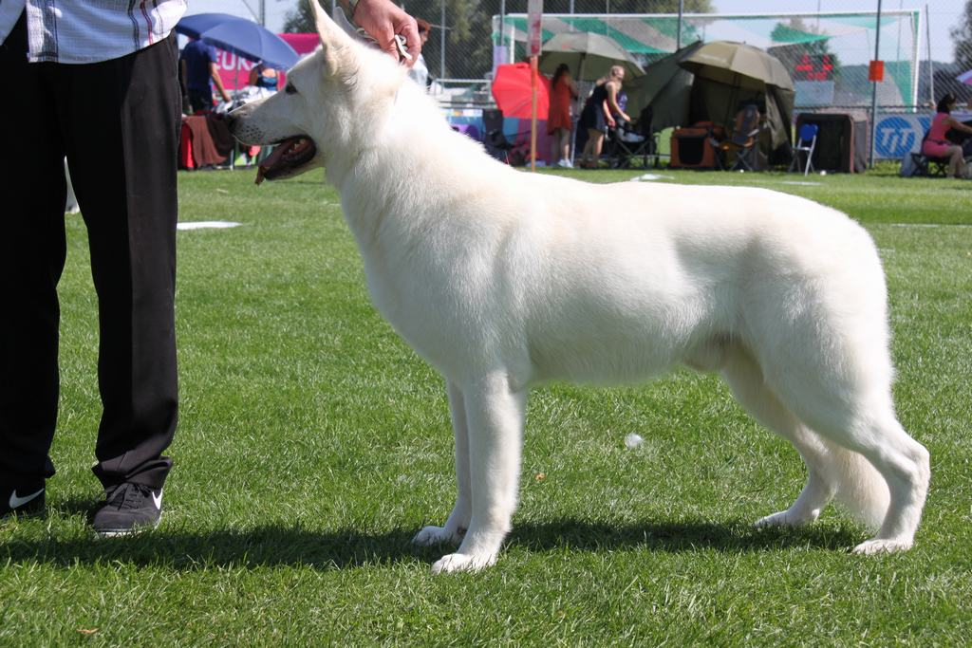
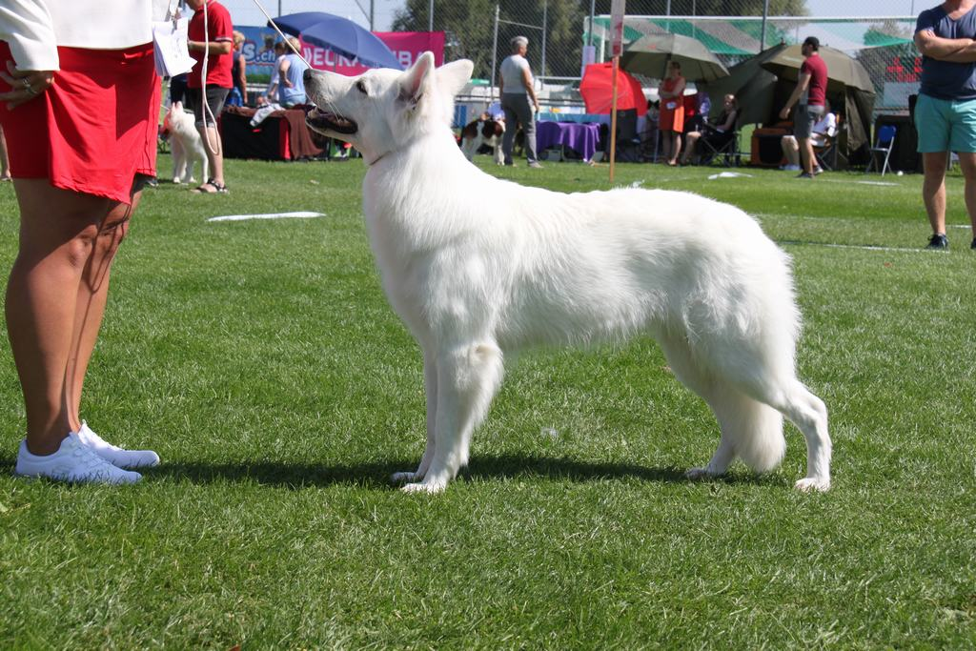
Breed standard
General appearance

Slide 10
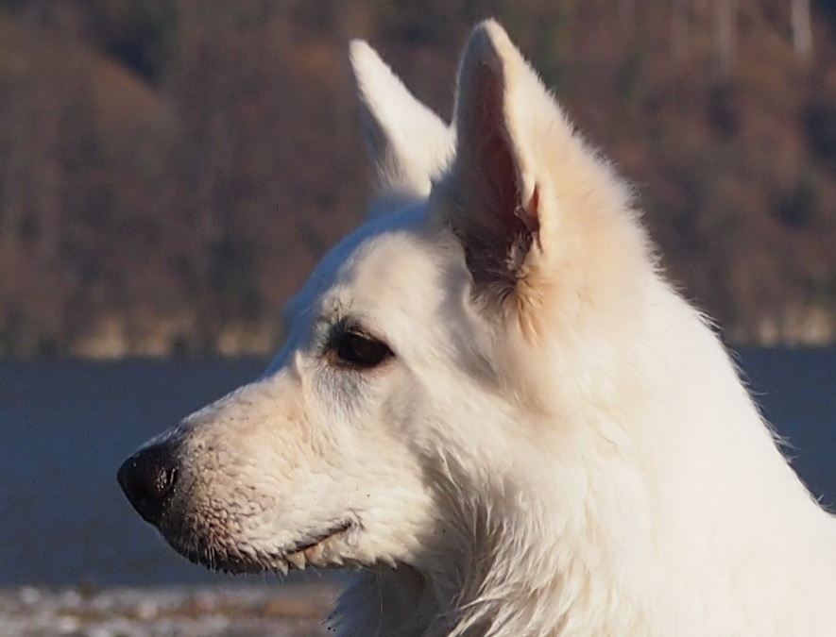
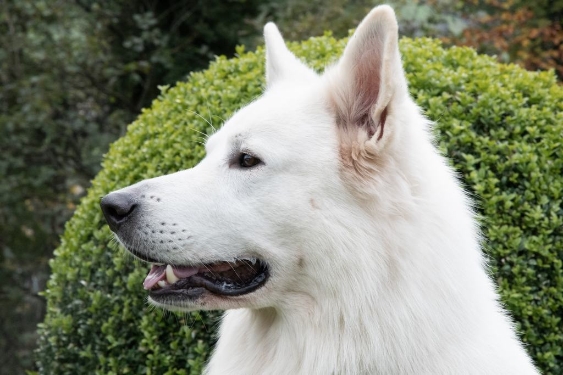
Breed standard
Muzzle moderately long in relation to the skull; top line of muzzle and skull are parallel

Slide 11
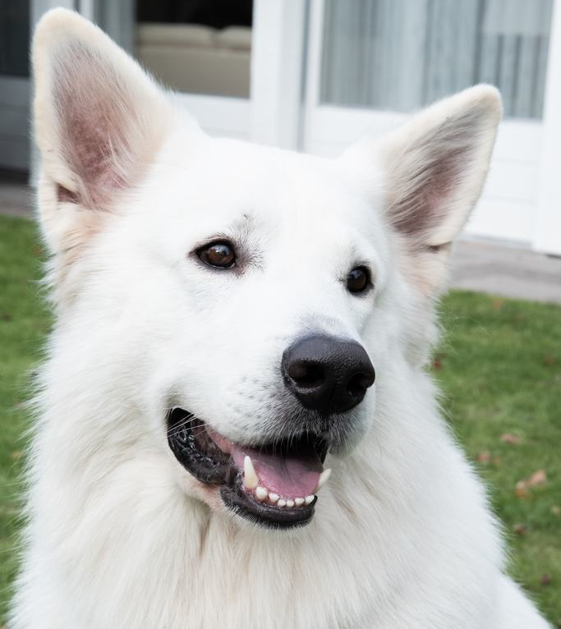
Breed standard
Dark pigmentation of swam, eyelid and lips

Slide 12
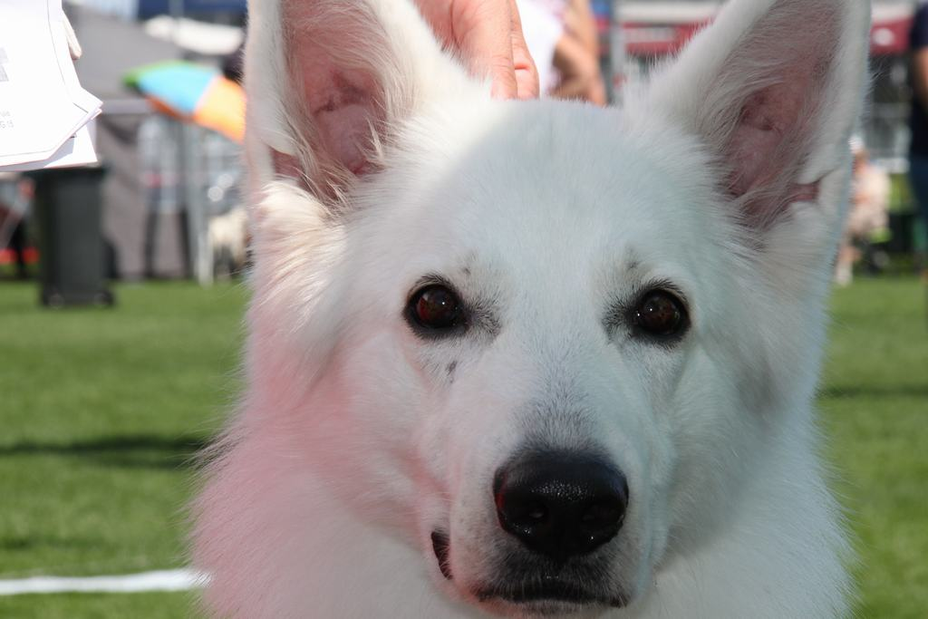
Breed standard
Almond shaped dark eyes

Slide 13
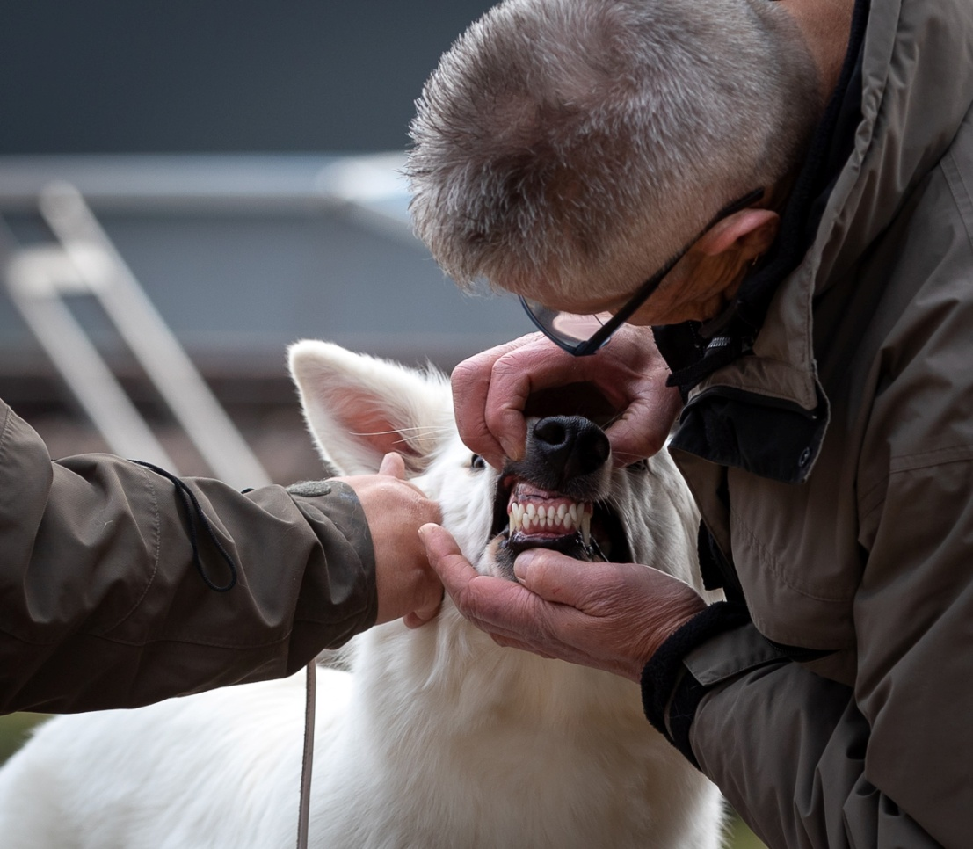
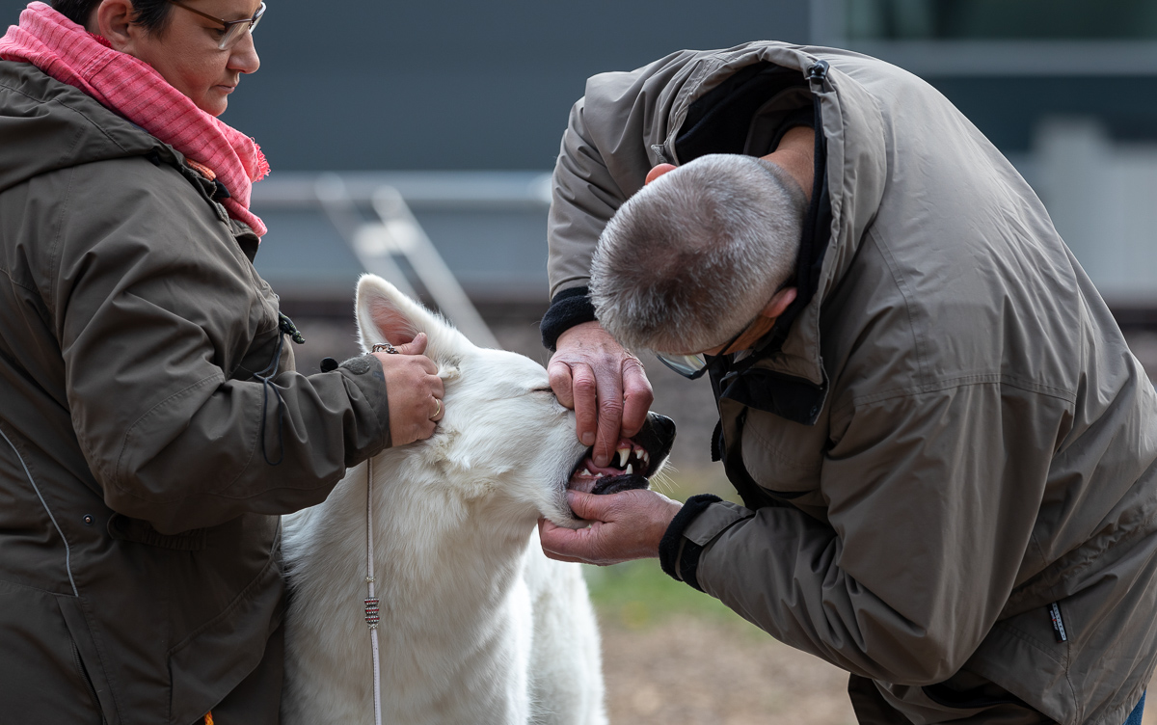
Breed standard
Complete scissor bite in good quality

Slide 14
Breed standard
Neck
Notes:
Neck with good reach

Slide 15
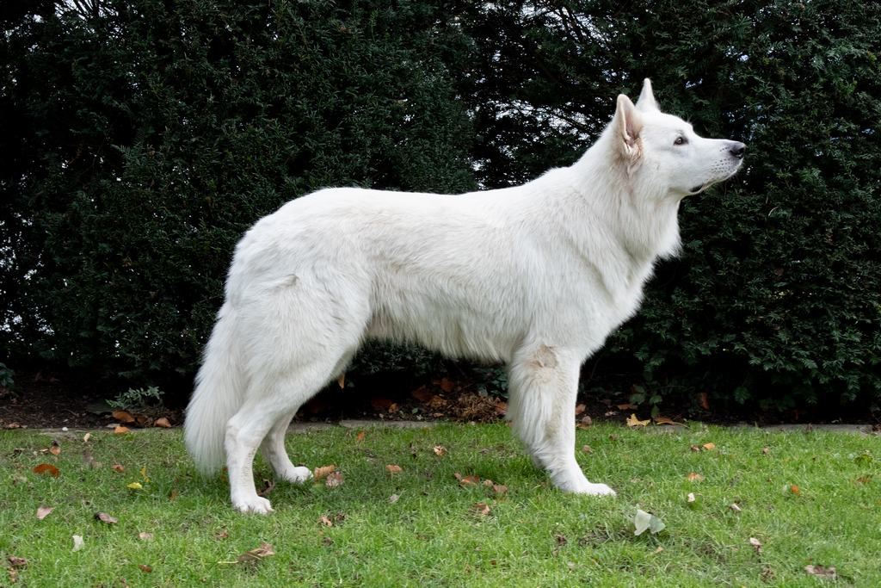
Breed standard
Back horizontal
Notes:
Back must be horizontally, never sloping

Slide 16
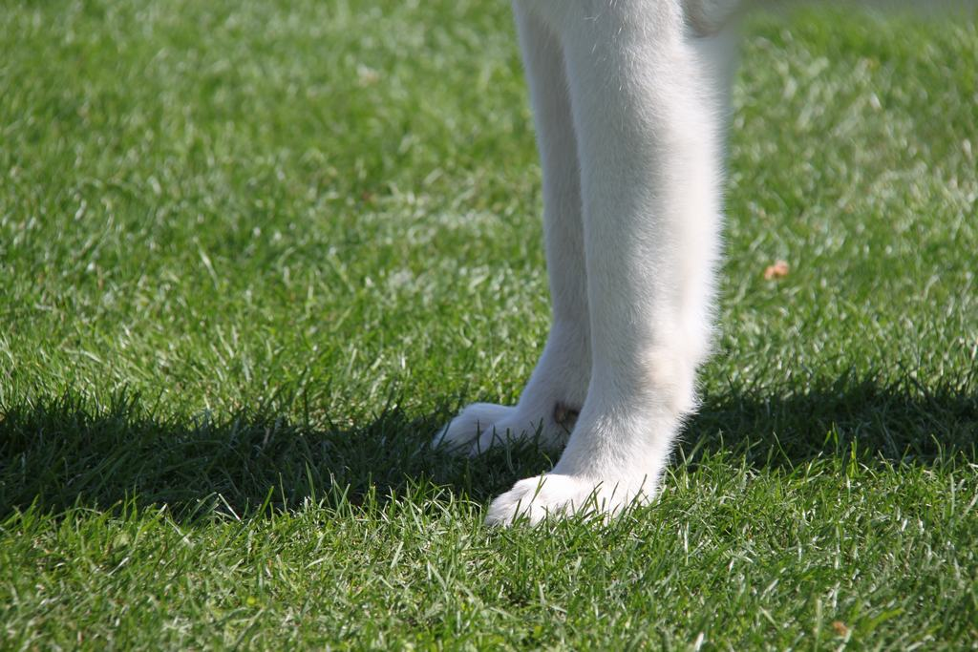
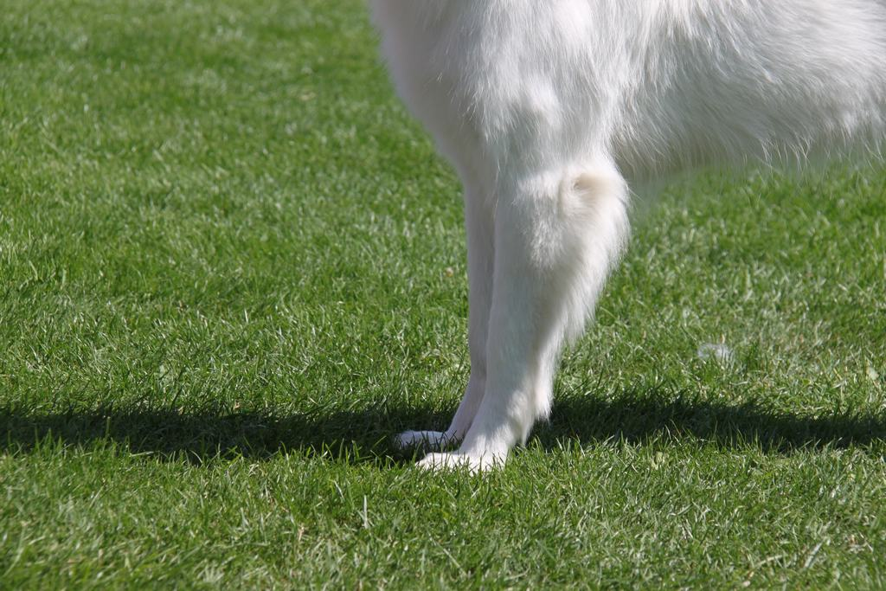
Breed standard
Angulation

Slide 17
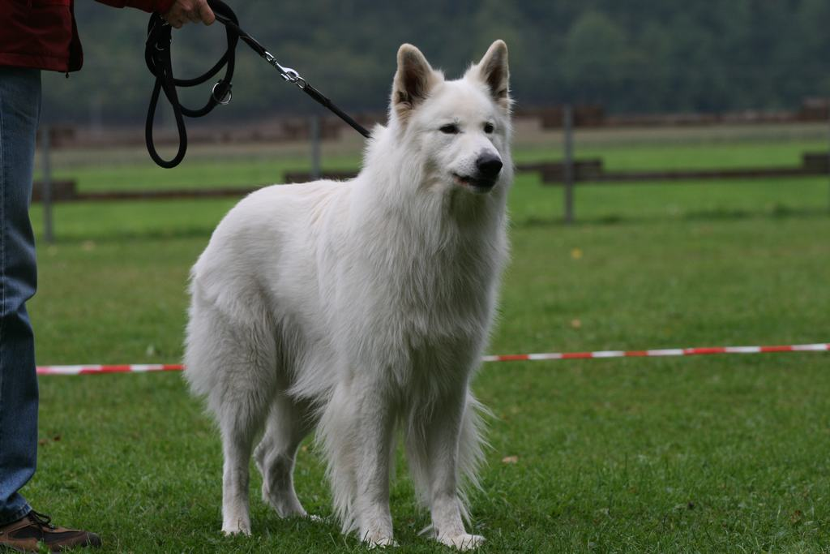
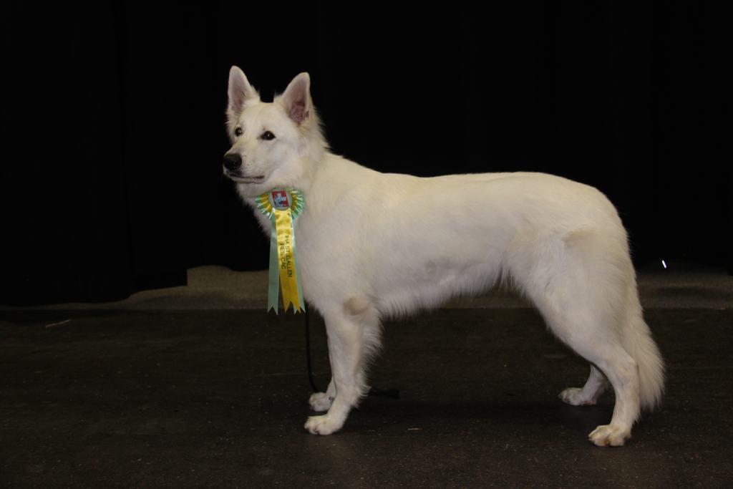
Breed standard
Haircolour and –length
Notes:
There are two lengts, which may be mixed in breeding: medium and long coat
Note: picture 2 the Bitch has a too soft carpal joint

Slide 18
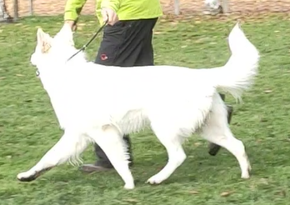
Breed standard
Tail and Movement
bushy, sabre tail, at rest hanging with light sabre curve, in action carried higher with tip slightly above topline
Notes:
Standing with a sabre tail
In movement tail with top line, slightly a bit higher possible

Slide 19
Breed standard
Limbs
Front and Back

Slide 20
Major fault 1
no horizontal back / sloping back
tail between legs on stomach (temperament)
lack of sex imprint
plump appearance, too short/square body
does not let teeth look at/missing more than 2 P1 teeth

Slide 21
Major fault 2
drop/break/semi-pricked ear
ring/break/hook tail, worn over back
soft or silky overcoat, wolly curly, not lying on body, no undercoat
strong yellow/brown coat on ears/back/tail

Slide 22
Disqualifiying faults 1
aggressive or excessive fearful dog
physical abnormalities or behavioral disorders must be disqualified
lethargic behavior
one/both eyes blue, protruding eye
ectropion / entropion

Slide 23
Disqualifiying faults 2
undershot bite / overbite / crossbite
no pigmentation
albinism
male dogs MUST have two normally developed testicles

Slide 24
Judging the breed ????
Judging according to the FCI standard
Judging in awareness of the function of the breed. Is the dog still fit for its original function and is the judge convinced that this dog can move, breathe and live in a normal way?

Slide 25
Related breeds
The White Swiss Shepherd Dog is related to the German Shepherd but is now distinct
In shows the WSSD will be presented with the handler next to it, and not have him follow the dog
Since the 1960s the WSSD has been bred in a distinct line, like HORIZONTAL back, rigorous control of HD/ED/etc. and TRANSITIONAL VERTEBRA plus several DNA defects

Slide 26
Problems to take into account
Health problems
Behaviour problems
Movement and other problems

Slide 27
Thank you to:
Daniela von Fluee – helping for the info frame
Hans Ulrich Haeberli – specialty breed judge
Anja Schleussner – pictures
Hans Ulrich Joerg – pictures
© Stephan Bolliger – president GWS Switzerland

