Slide 1
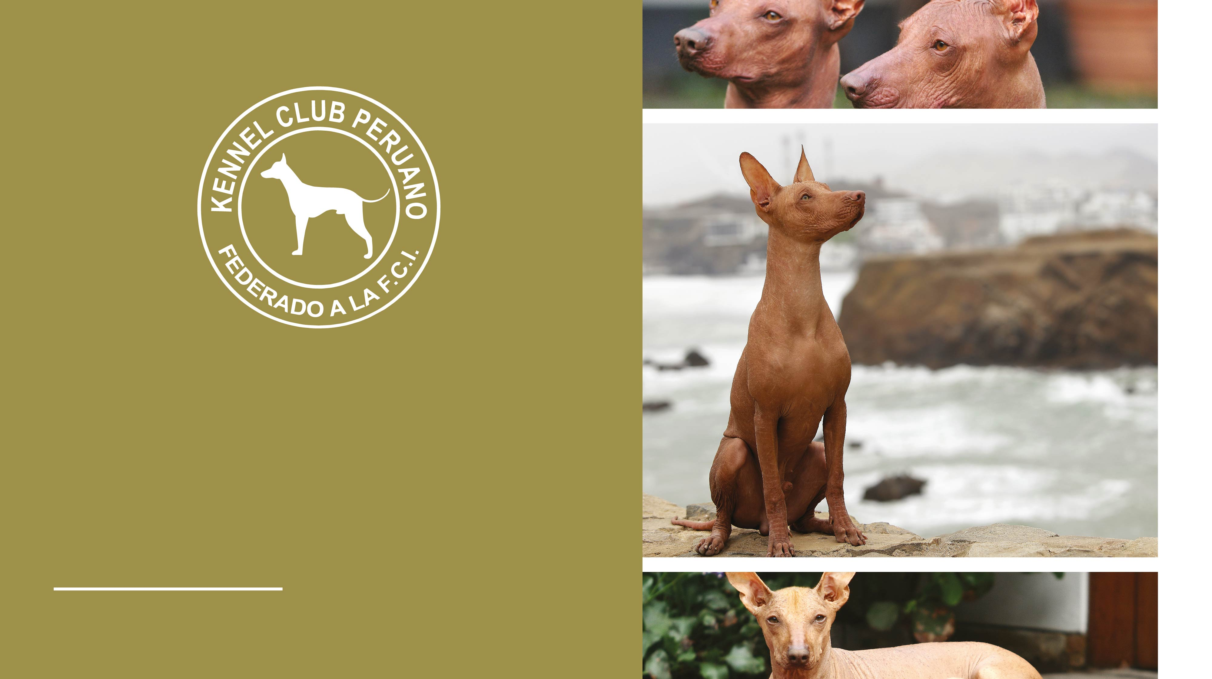

Breed:
THE PERUVIAN HAIRLESS DOG
FCI-Standard N° 310
13.08.2013 / EN

Slide 2
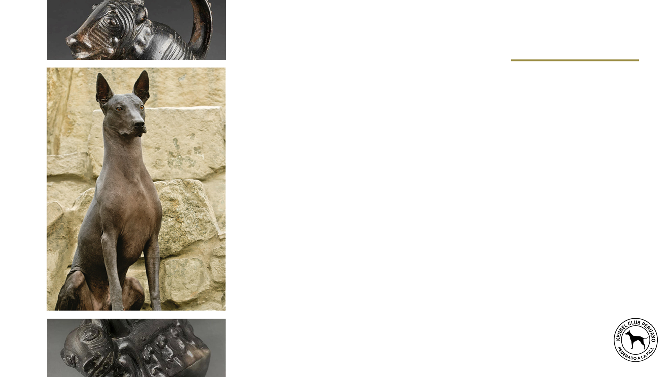
Brief historical summary
The Peruvian hairless dog, known as “viringo”, because of its particular nature, was the subject of obvious curiosity by the Peruvians from different times. Because of the allocation of different properties, they are seen on ceramics of different cultures pre-Incas like Vicus, Mochica, Chancay, Chancay with Tiahuanaco influence, Chimu and others where in many cases the hairless dog has replaced the puma, the snake or the hawk, standing with the greatest interest in the Chancay culture. As seen in these illustrations, the hairless dog makes its appearance in the archaeological periods of Pre-Inca times, from 300 BC until 1460 AD.

Slide 3

General appearance
In general terms, the Peruvian hairless dog can be described as a slender and elegant animal, with a physique that implies speed, strength and harmony, with no hint of coarseness.
Two varieties exist: the hairless dog, the main characteristic of which is the absence of a coat; and the coated variety, completely covered in hair over its entire body. The hairless variety also tends to possess an incomplete set of teeth. This is a genetic factor associated with its congenital alopecia.

Slide 4

Important proportions
The relationship between height at the withers and body length is 1:1, although the body of the female can be a little longer than that of the male.
LENGTH
HEIGHT

Slide 5
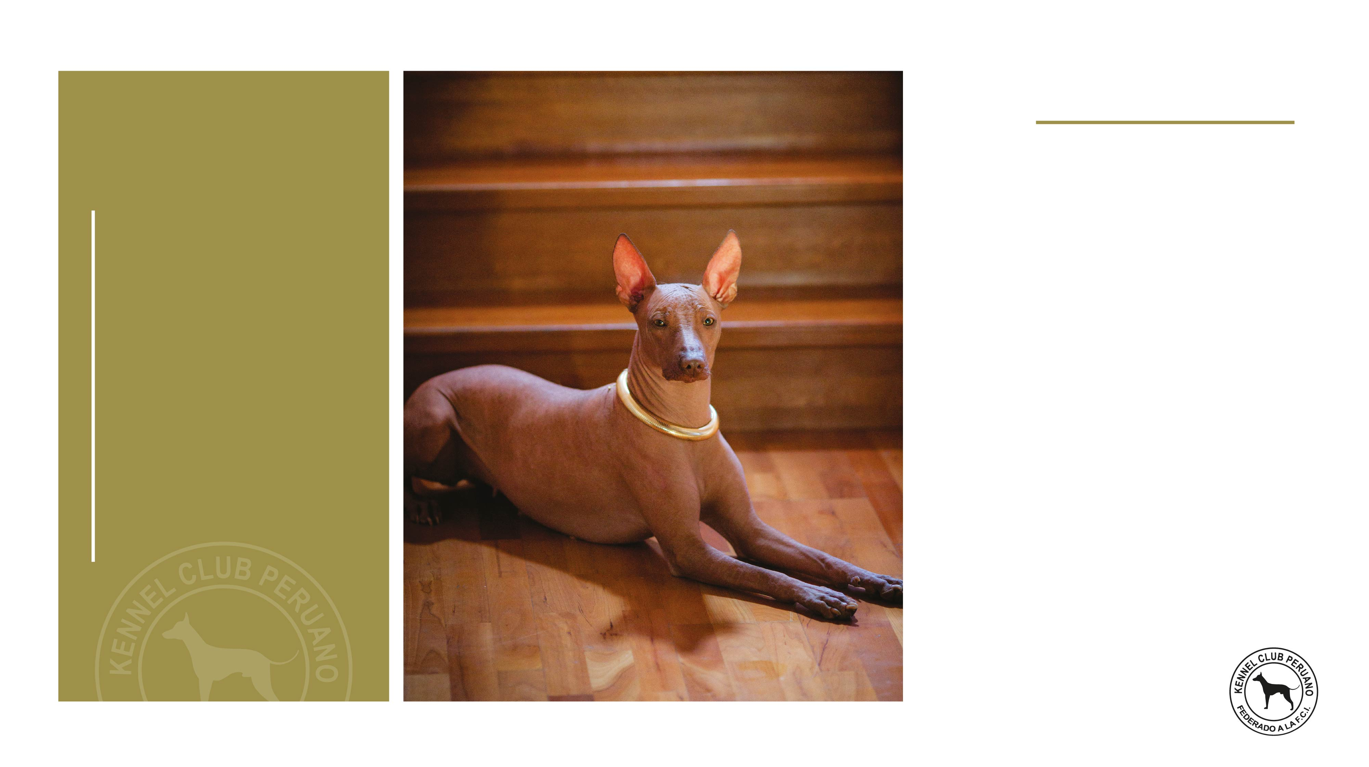
Behaviour / Temperament
Noble and affectionate at home with those close to him, at the same time lively and alert; he might be wary of strangers and is a good watch dog.

Slide 6
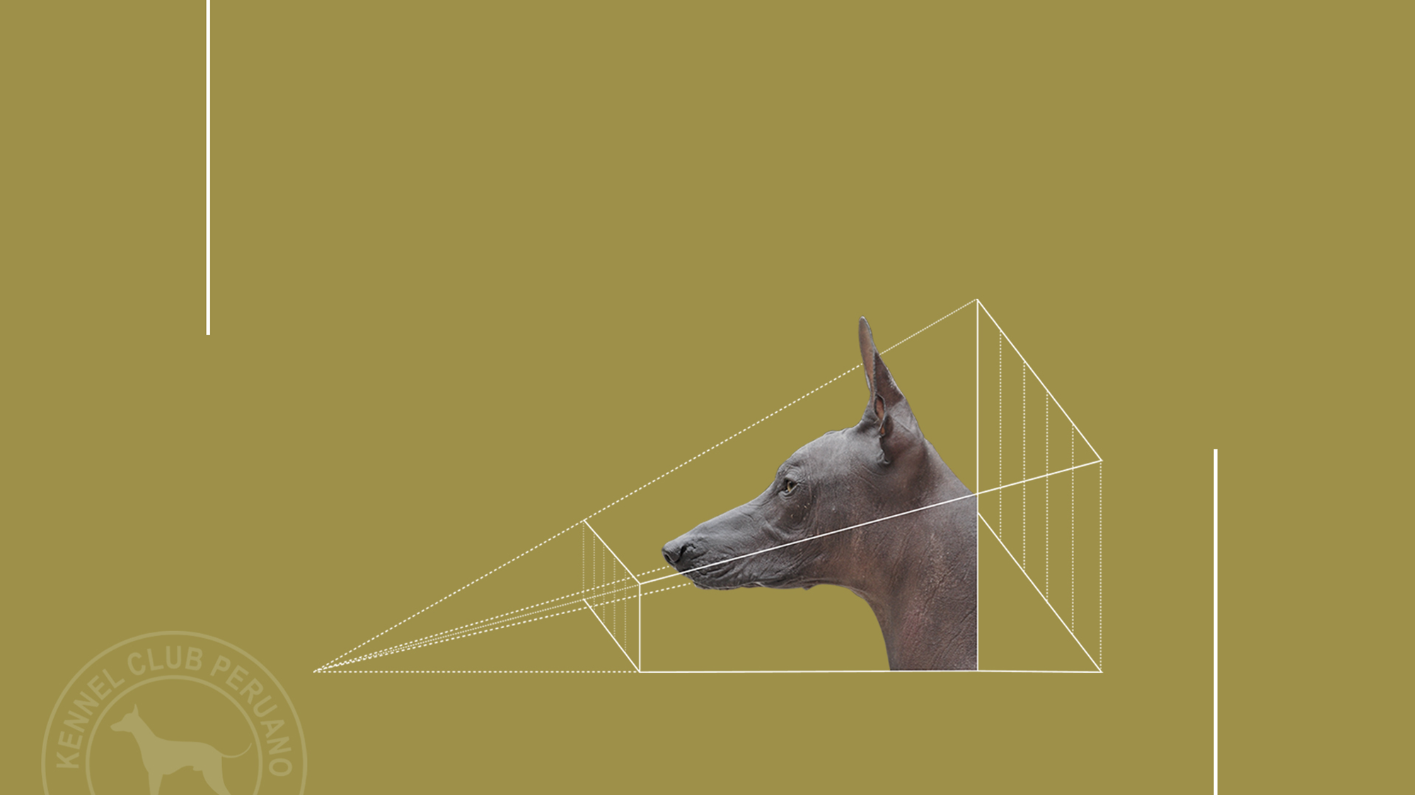
01.
Cranial Region
02.
Facial Region
Head
Of lupoid conformation.

Slide 7
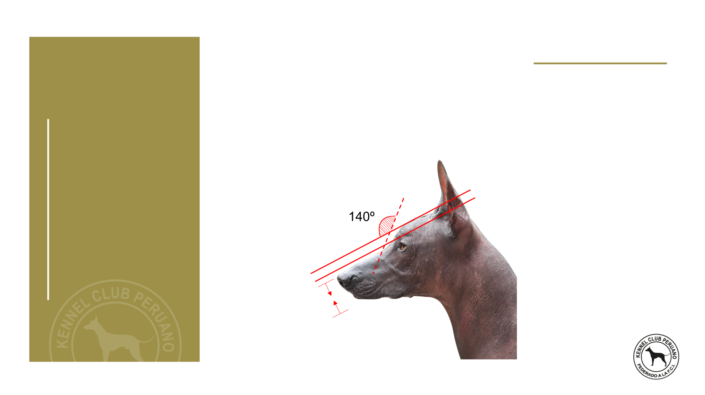
01.
Cranial Region
Skull
Mesocephalic. Orthoid, i.e. the upper axes of the skull and muzzle are parallel; a slight divergence is accepted. Seen from above, the skull is broad and the head tapers toward the nose. The superciliary arches are moderately developed. The occipital protuberance is barely marked.
Slightly marked
(Approximately 140º)

Slide 8
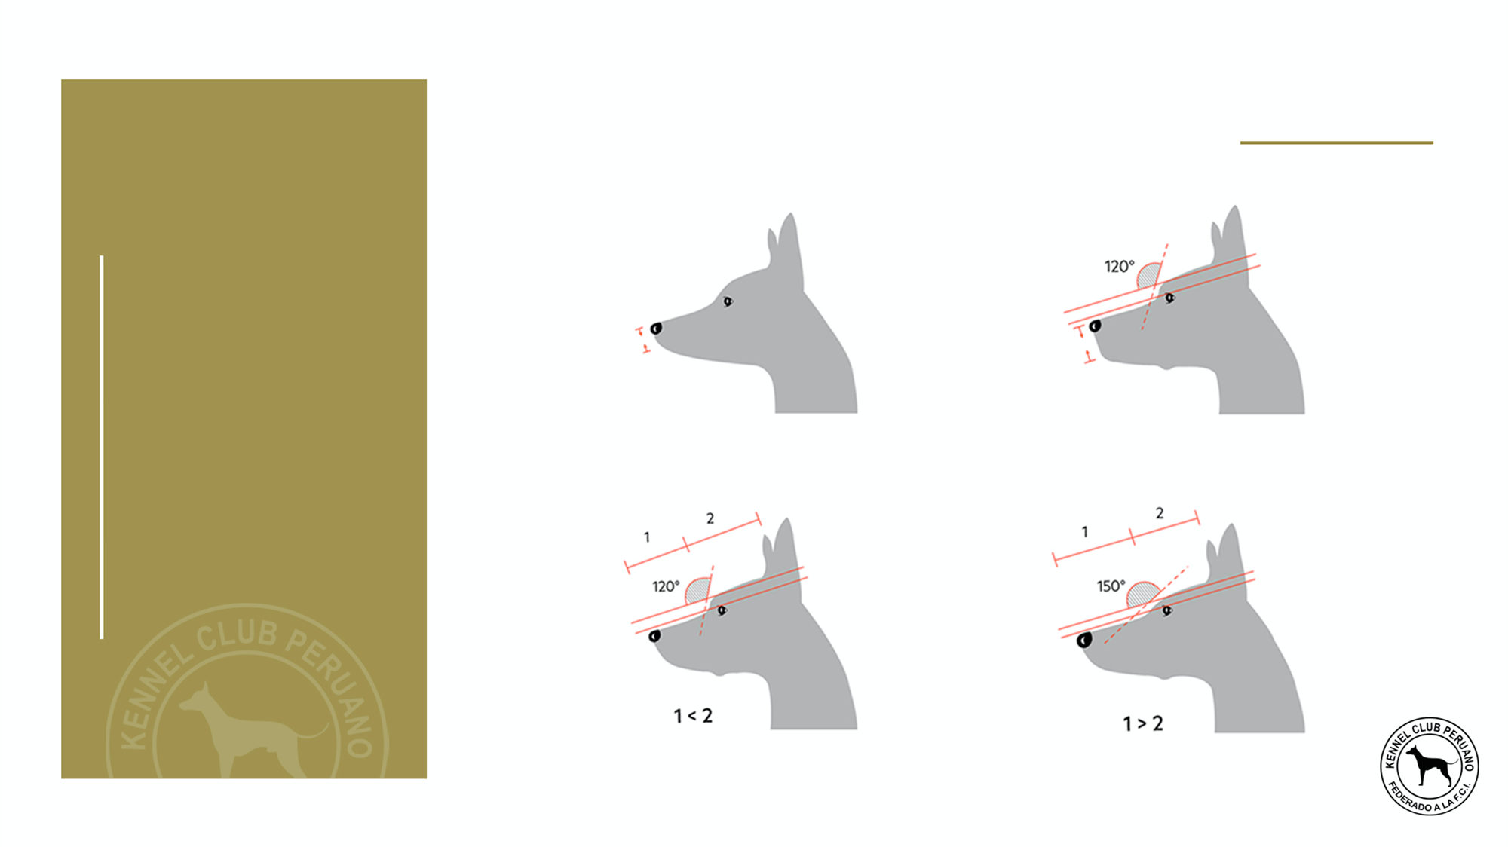
Stop:
Slightly marked (approximately 140°).
01.
Cranial Region
INCORRECT STOP
WEAK MUZZLE
TOO SHORT MUZZLE, NOTICEABLE STOP
TOO SHORT MUZZLE, NOTICEABLE STOP
TOO LONG MUZZLE, UNNOTICEABLE STOP

Slide 9
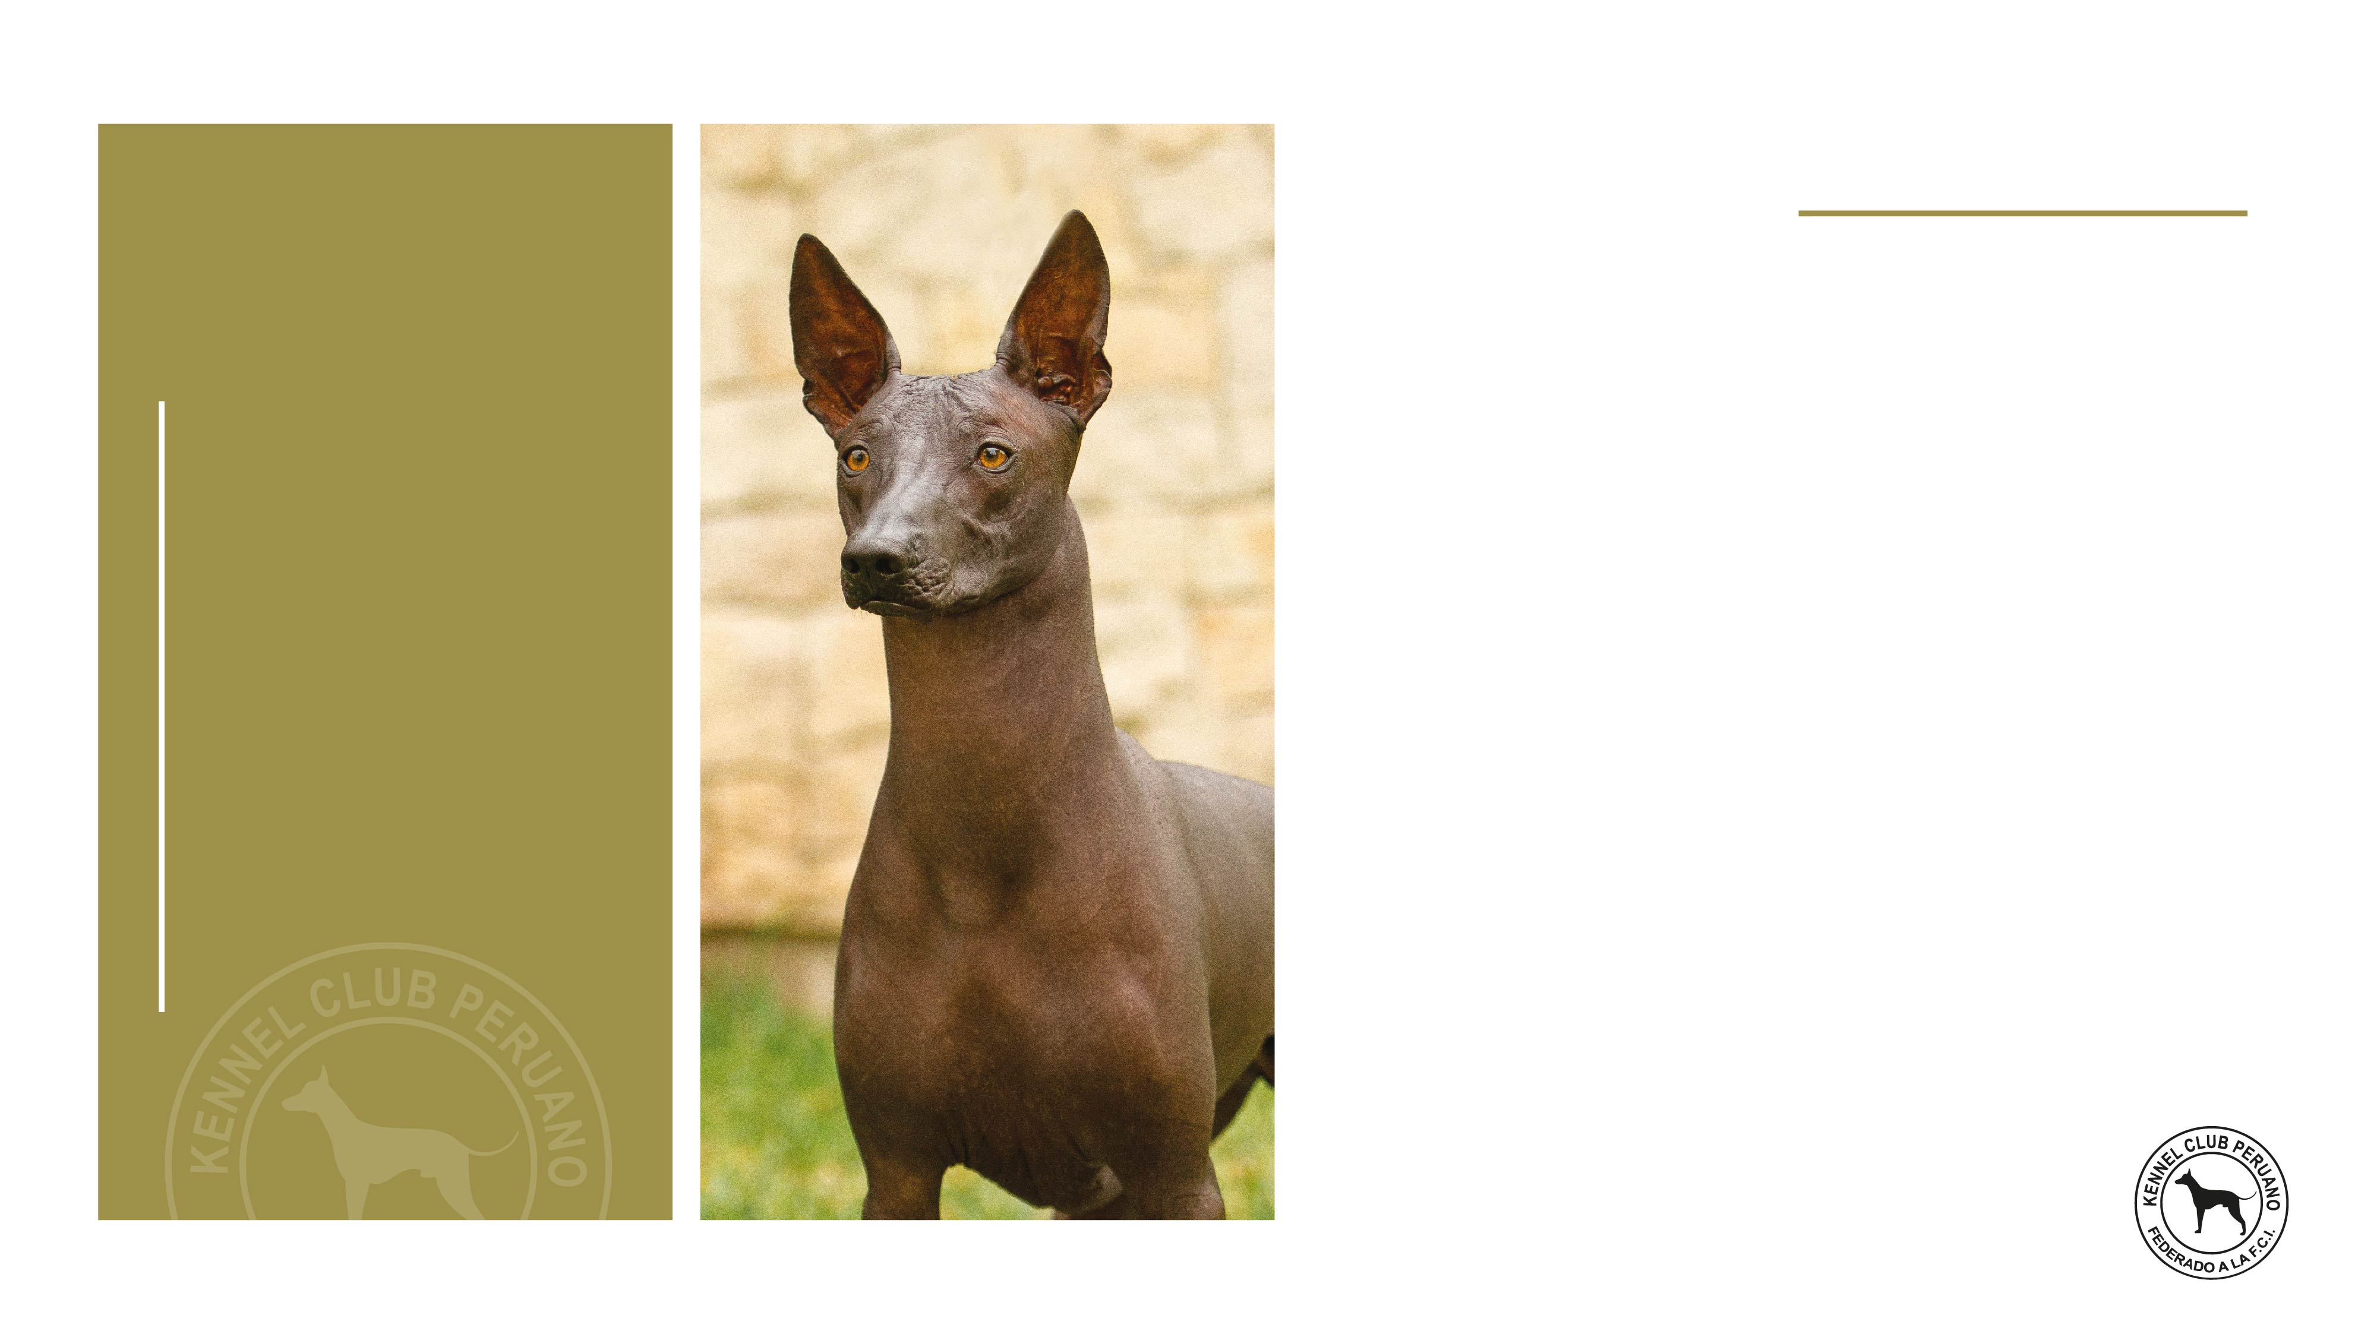
Nose
02.
Facial region
Good pigmentation, the colour of the nose must be in harmony with the different colours of the skin; in the different shades in the hairless variety and with the colour of the hair in the coated variety.

Slide 10
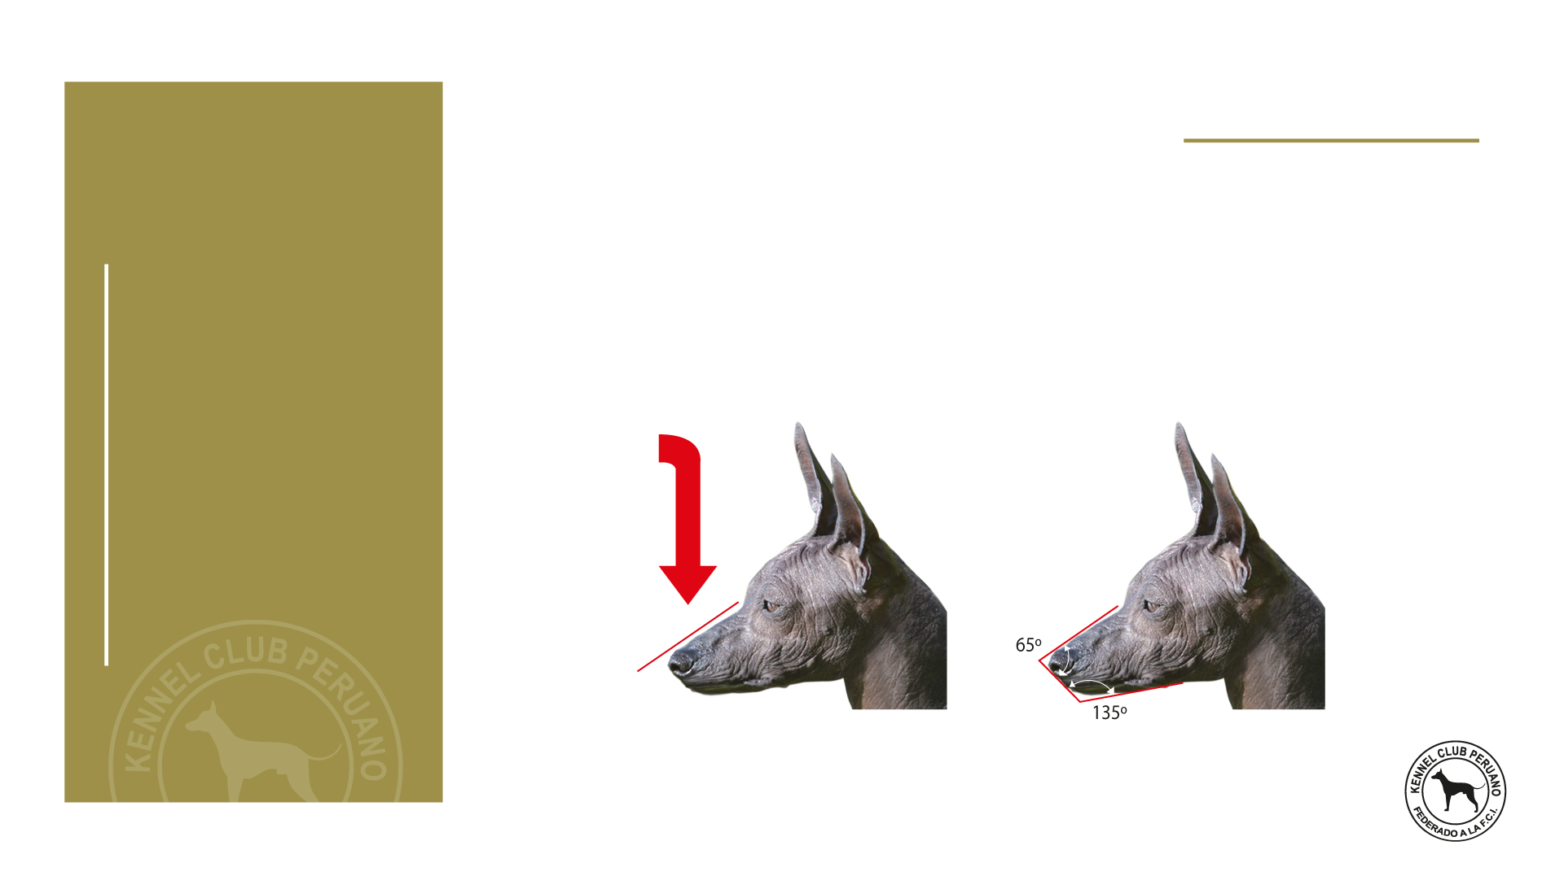
Muzzle
02.
Facial region
Seen in profile, the nasal bridge is straight.
Retocador: Dany Sotelo
STRAIGHT SUPERIOR LINE
APPROXIMATELY MUZZLE´S ANGLES

Slide 11
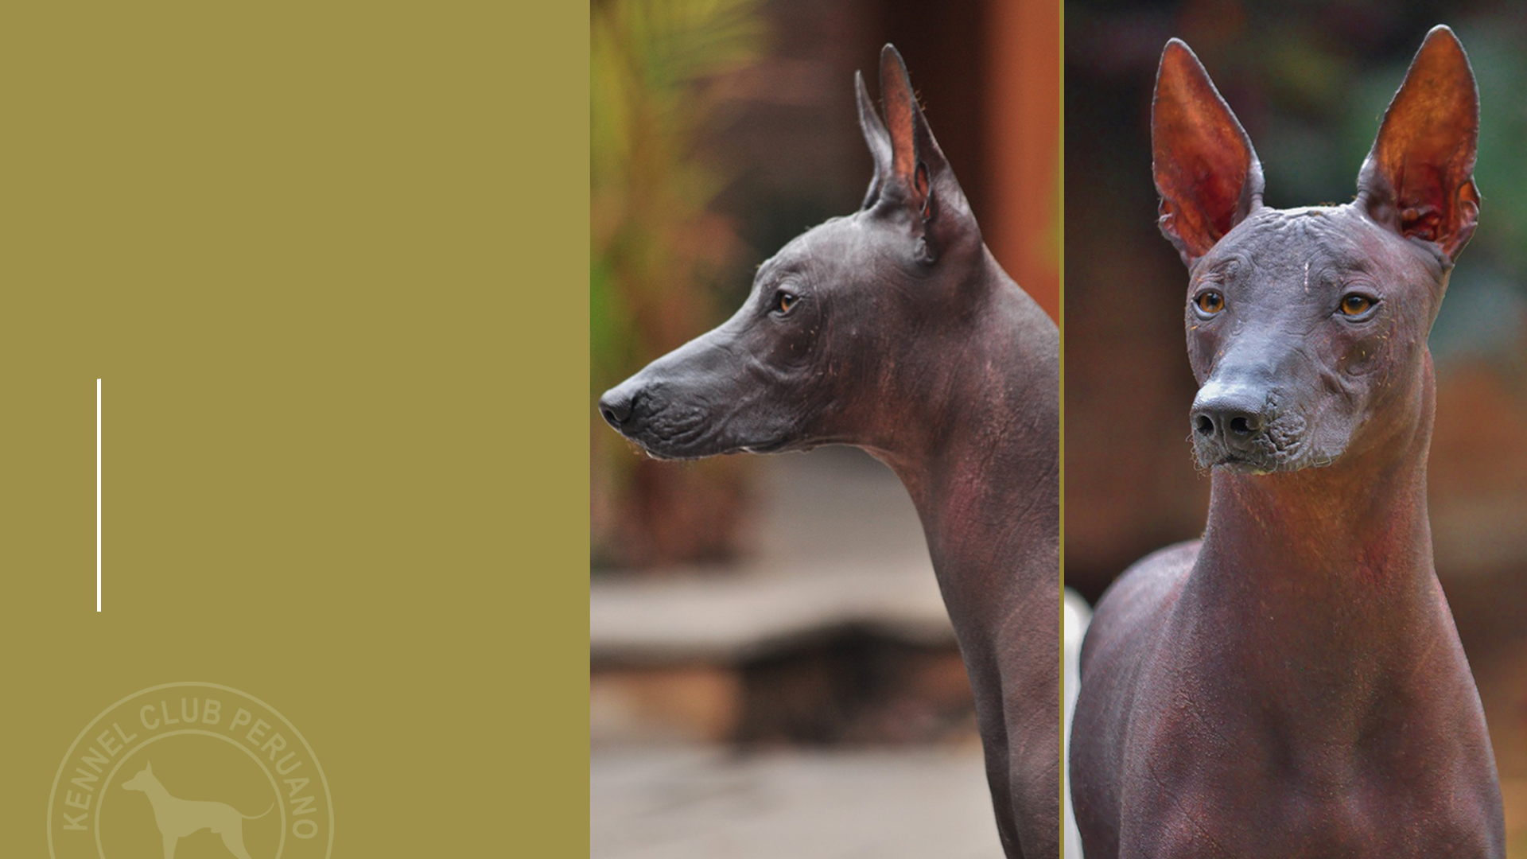
02.
Facial region
Lips
They must be as tight as possible and close to the gums.

Slide 12
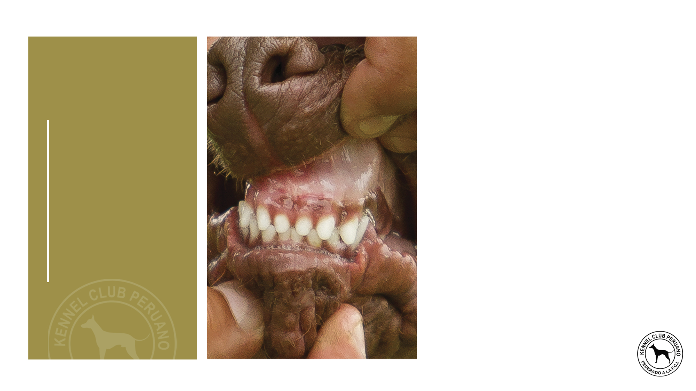
Jaws / Teeth
02.
Facial region
The incisors should fit in scissor bite. In the hairless variety the absence of one or more teeth is accepted. In the coated variety the dentition must be complete with teeth normally developed and in a normal position. The jaw is not strongly developed.

Slide 13
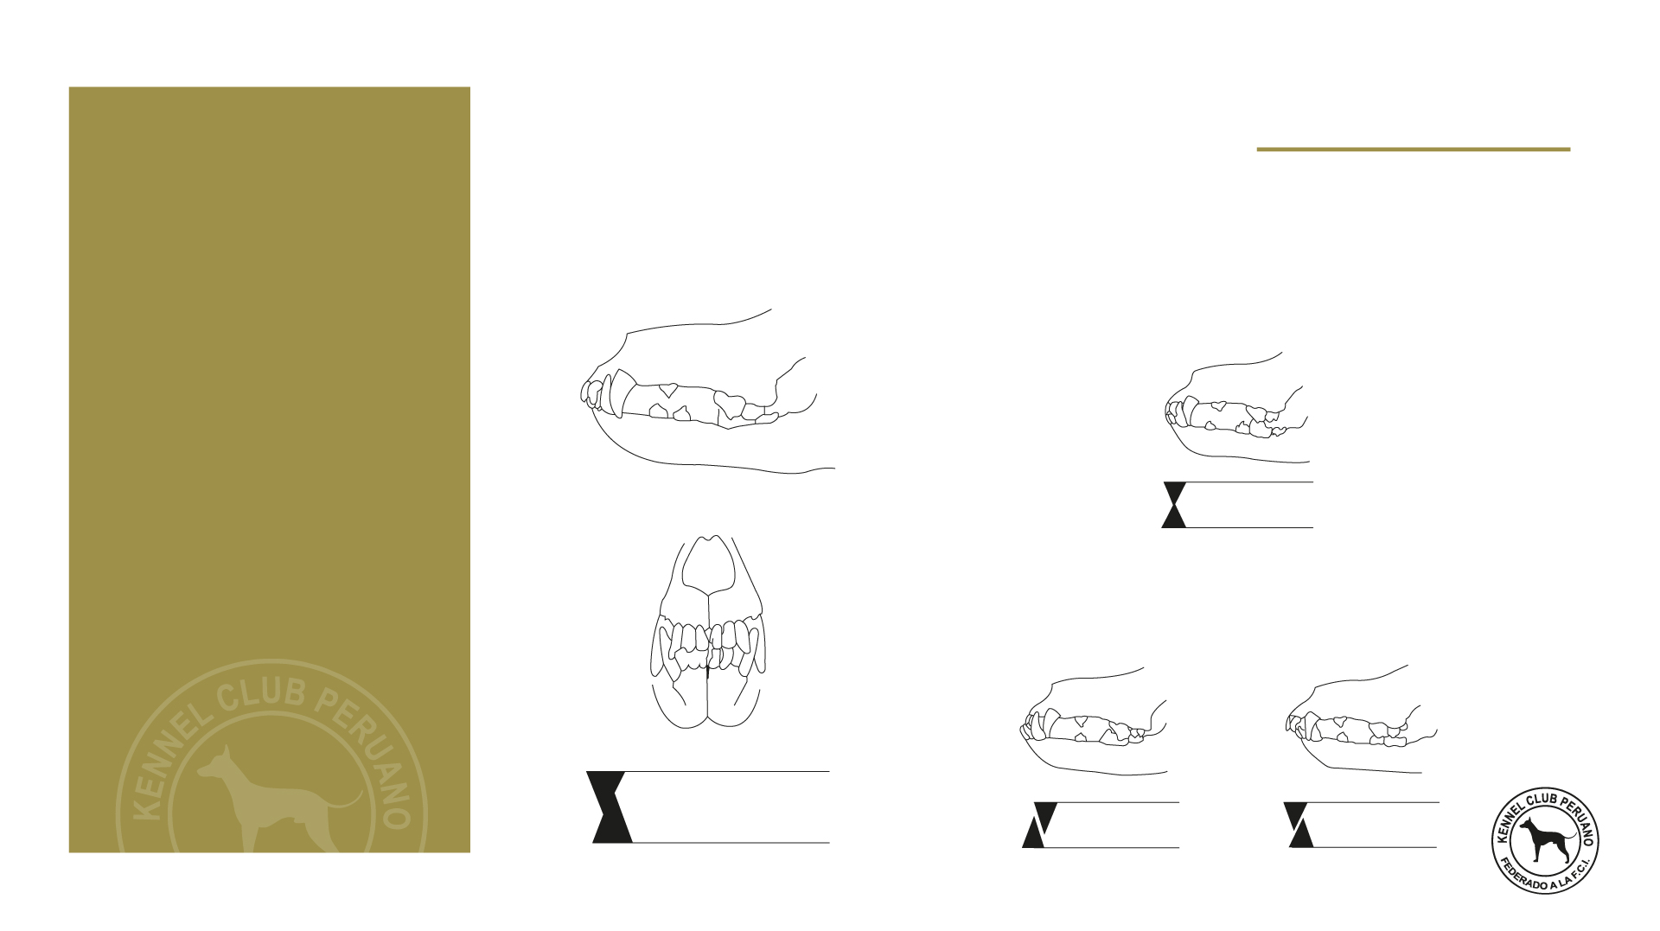
Jaws / Teeth
02.
Facial region
CORRECT BITE
INCORRECT BITE
Level bite
Scissor bite
Undershot bite
Overshot bite

Slide 14
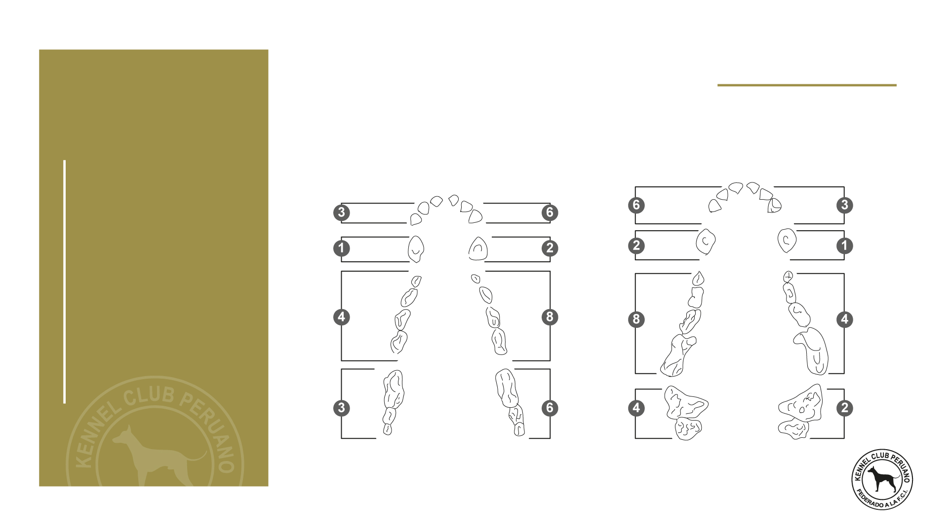
Jaws / Teeth
02.
Facial region
LOWER TEETH
UPPER TEETH
Incisors
Incisors
Canine
Canine
Premolars
Premolars
Molars
Molars
Dental composition of coated variety

Slide 15
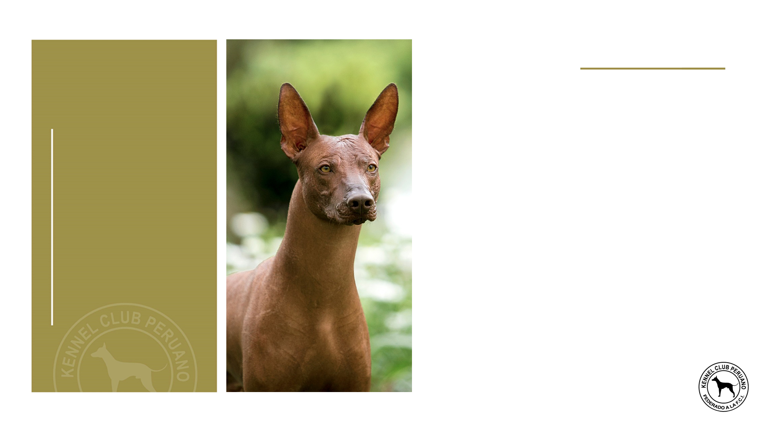
Cheeks
02.
Facial region
Developed without exaggeration.

Slide 16

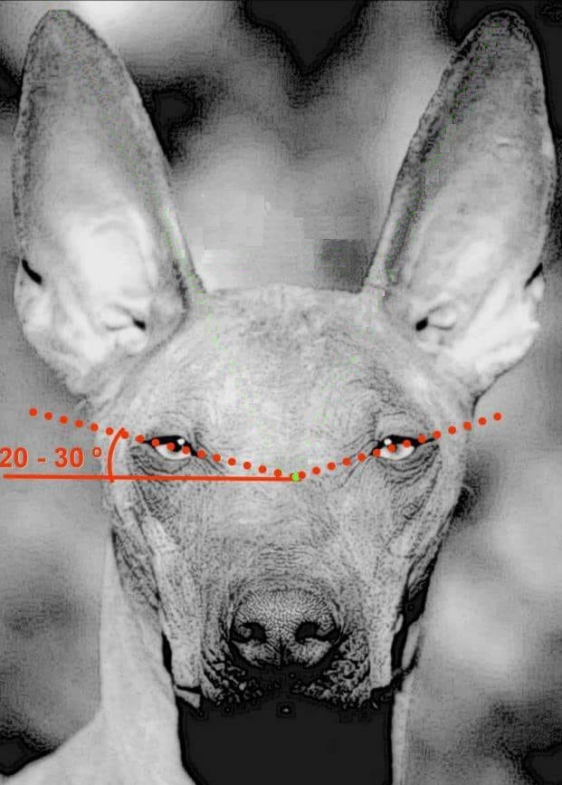
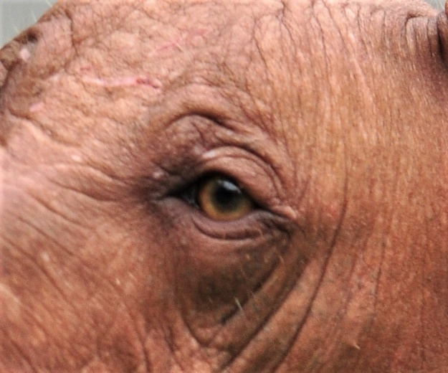
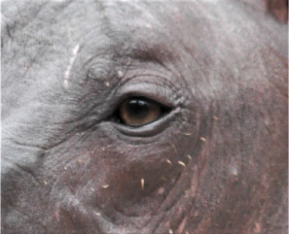
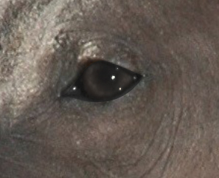
Eyes
02.
Facial region
Alert and intelligent expression. The eyes must be of average dimensions, slightly almond shaped, neither deep-set nor prominent, normally and regularly placed, i.e. neither too close together nor too wide apart. The colour can vary from black, going through all shades of brown to yellow, in harmony with the skin colour in the naked variety and with the coat in the variety with hair. In any case, both eyes must be of the same colour.
The colour of the eyelids may go from black to pink in subjects with light coloured face. The light pink colours are admitted but not sought after.

Slide 17
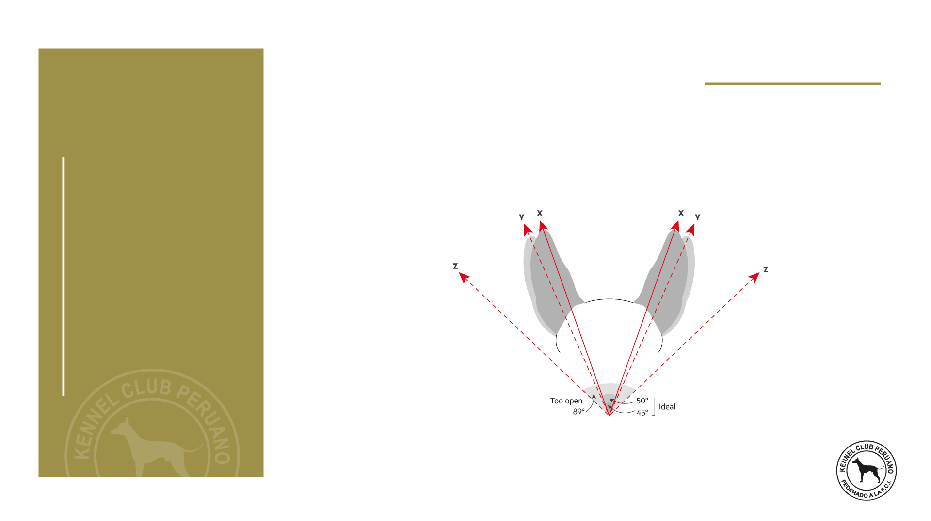
Ears
02.
Facial region
The ears must be pricked when the dog is attentive, whereas at rest, they are laid towards the back. The ears are of medium length; broad at the base, tapering progressively towards the tip, ending almost pointed. The ear set starts on the upper part of the skull to end laterally and obliquely. In erect position, the axes of the ears form a variable angle from 50° to near 90°.
X and Y axes form an Isosceles triangle with the tip of the nose.

Slide 18
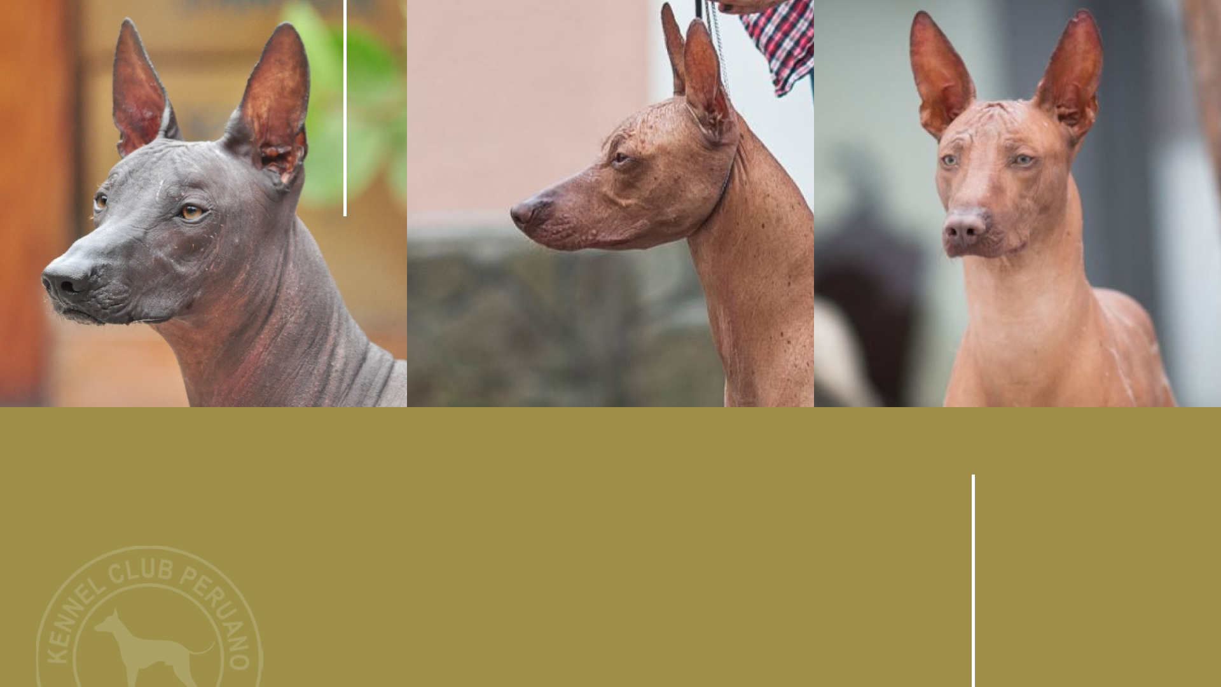
Correct Head
FRONT AND LATERAL VIEW

Slide 19
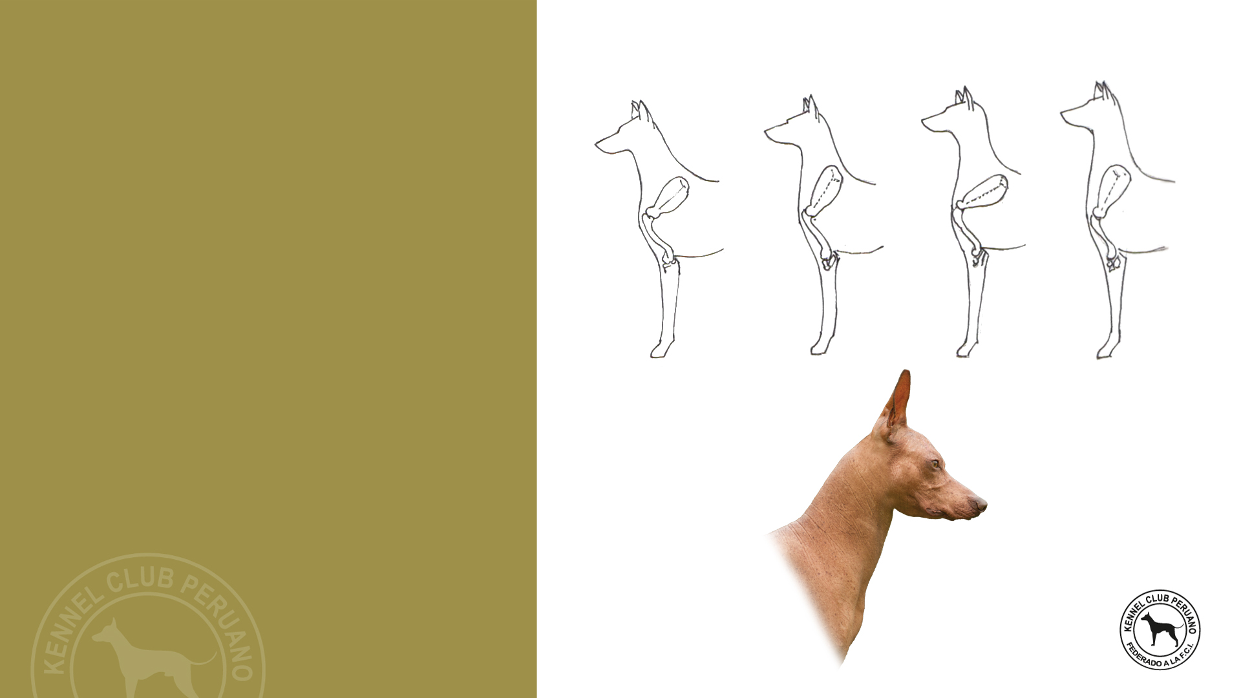
CORRECT
SHORT
SWAN
LONG
Neck
Upper profile: Curved (convex).
Length: Approximately the same length as the head.
Shape: Near to a truncated cone shape, supple, with good musculature.
Skin: Fine, smooth, elastic and really close to the subcutaneous tissues. No dewlap.

Slide 20
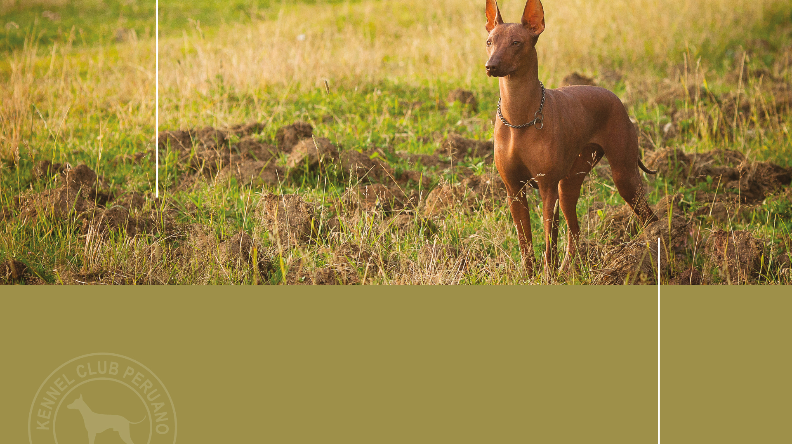
Body
01.
Topline
02.
Withers
03.
Back
04.
Loin
05.
Croup
06.
Chest
07.
Underline and belly
Mesomorphic

Slide 21
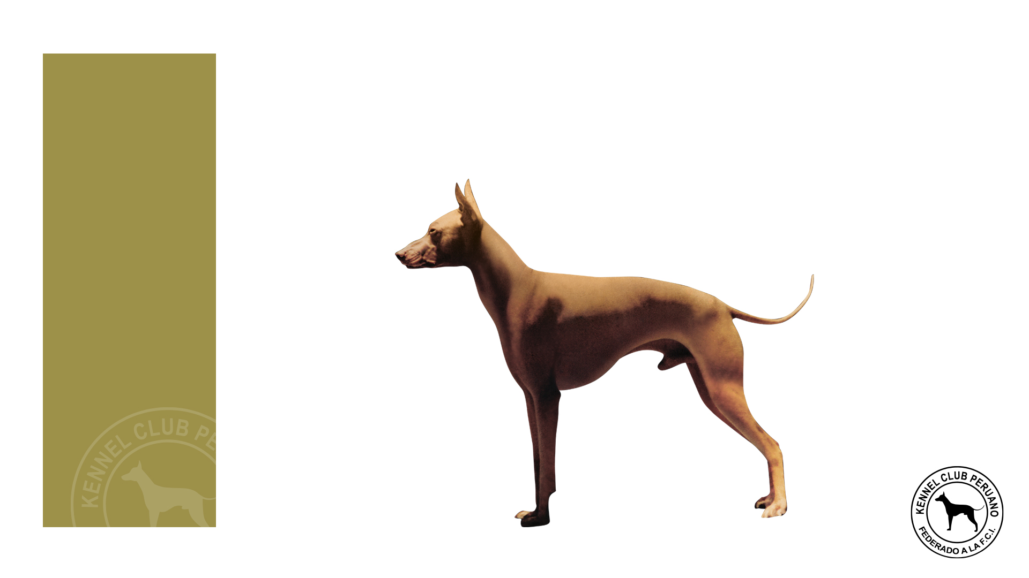
Mesomorphic
Body
The Peruvian hairless dog is defined as mesomorphic in accordance with accepted body index classification.
IC =
Longitudinal trunk axis x 100
8
Thoracic Perimeter
3
4
Mesomorphs have a body index of betwenn
71 and 84.
5
1
1. Thoracic Length
2. Withers
3. Back
4. Loin
5. Group
6. Chest
7- Bottom profile/ Belly
8. Thoracic perimeter
2
7
6

Slide 22
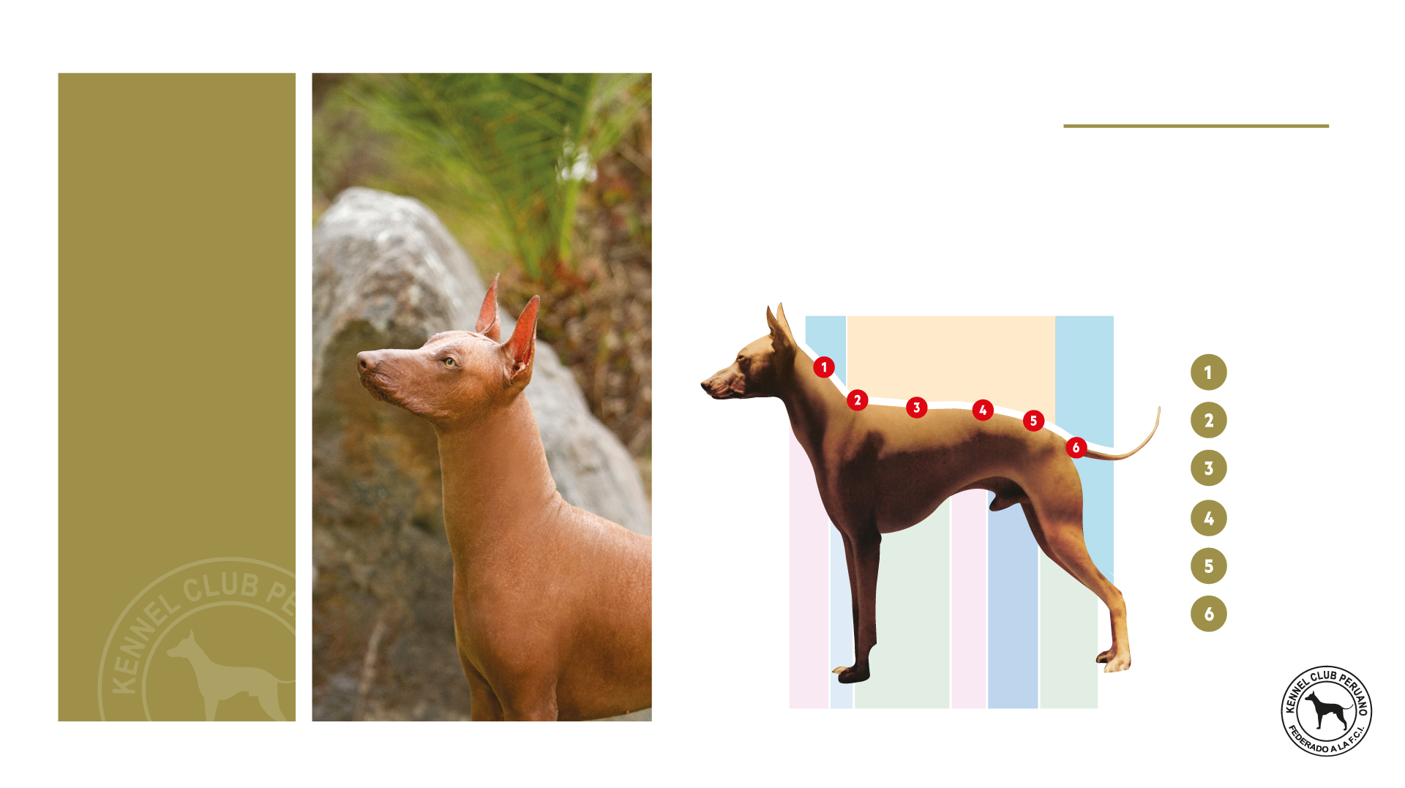
Topline
Body
Level, although certain subjects show a dorsal-lumbar convexity, which disappears at croup level.
Neck
Withers
Back
Loin
Croup
Tail

Slide 23
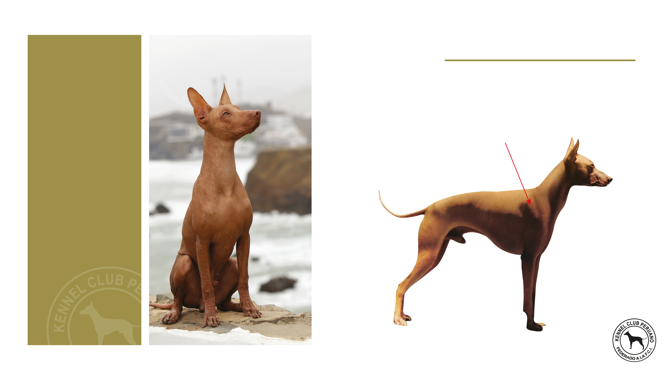
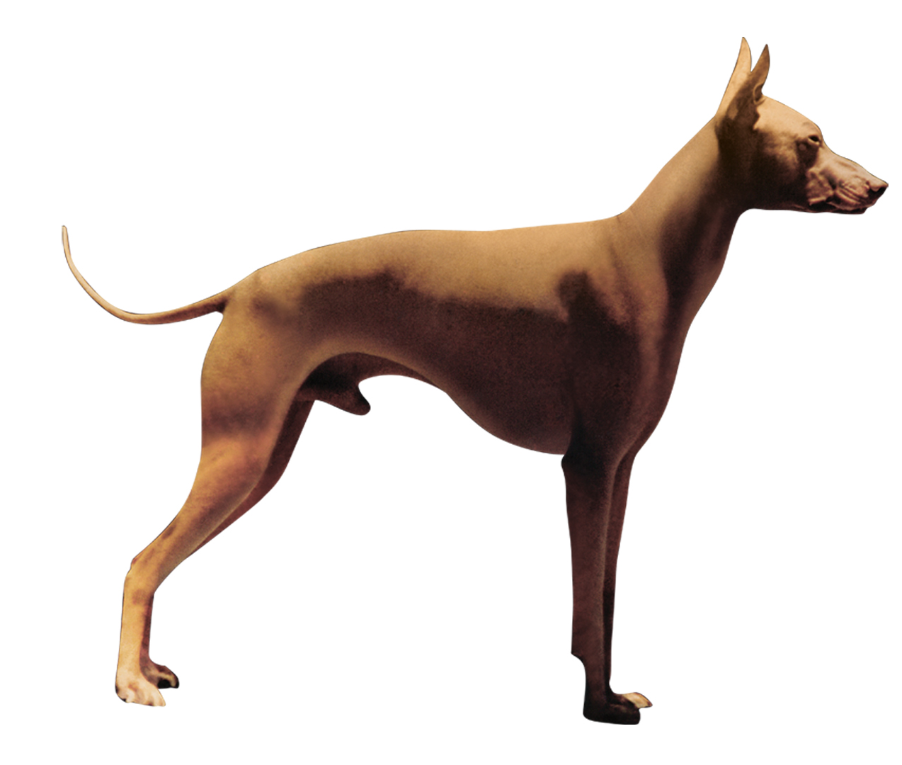
Withers
Body
Barely accentuated.
Withers

Slide 24
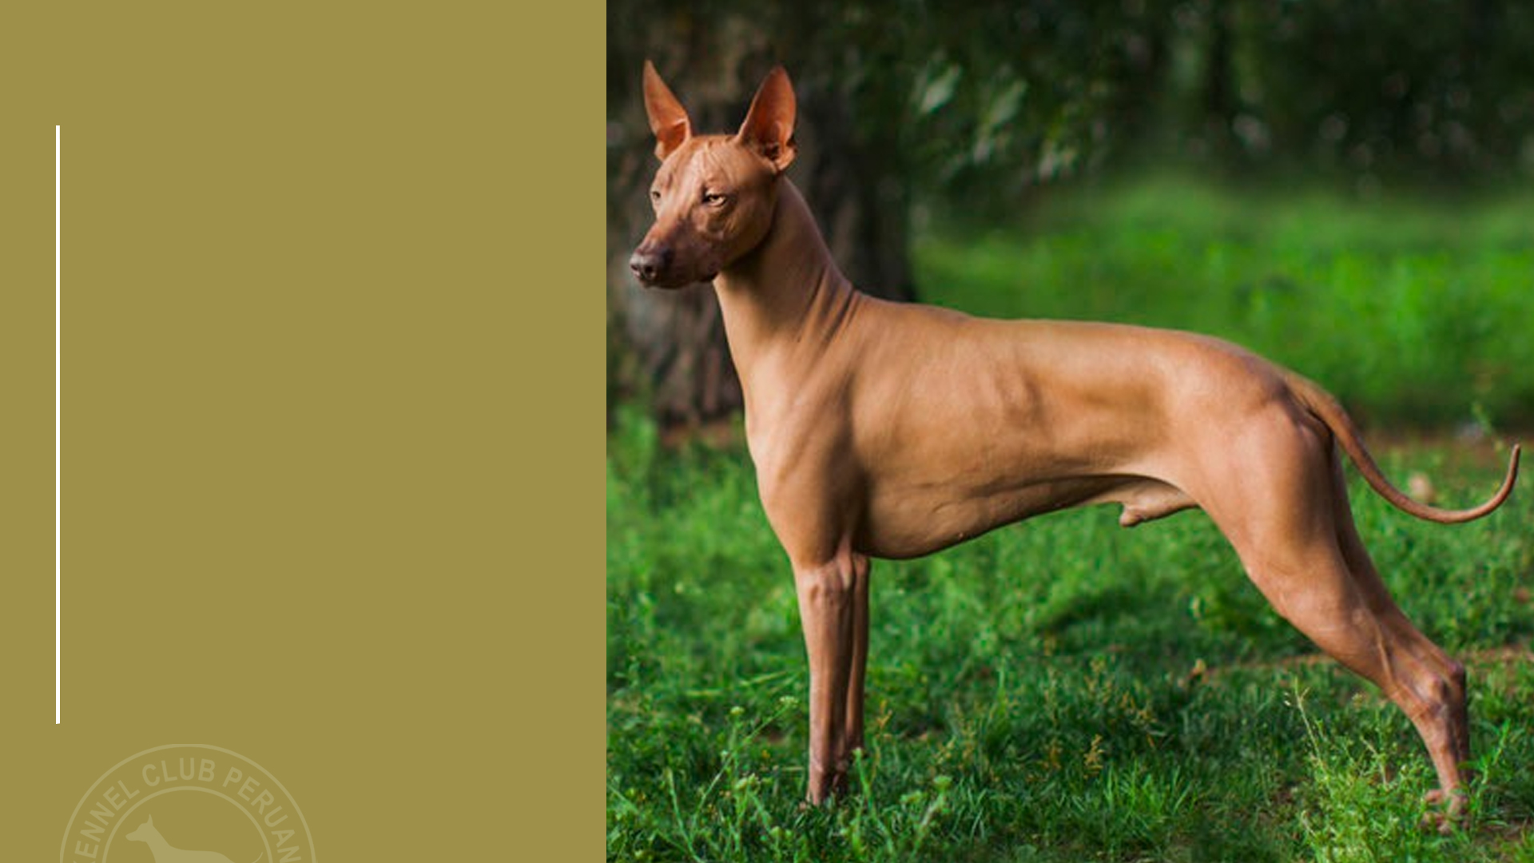
Body
Back
Straight, with well-developed back muscles often forming all along the back a muscular bi-convexity, which extends to the lumbar region.
Loin
Strong and well-muscled. Its length reaches approximately 1/5 of the height at the withers.
Croup
The superior profile is slightly convex, slanting approximately 40° to the horizontal. Solid and well-muscled giving a good push.

Slide 25
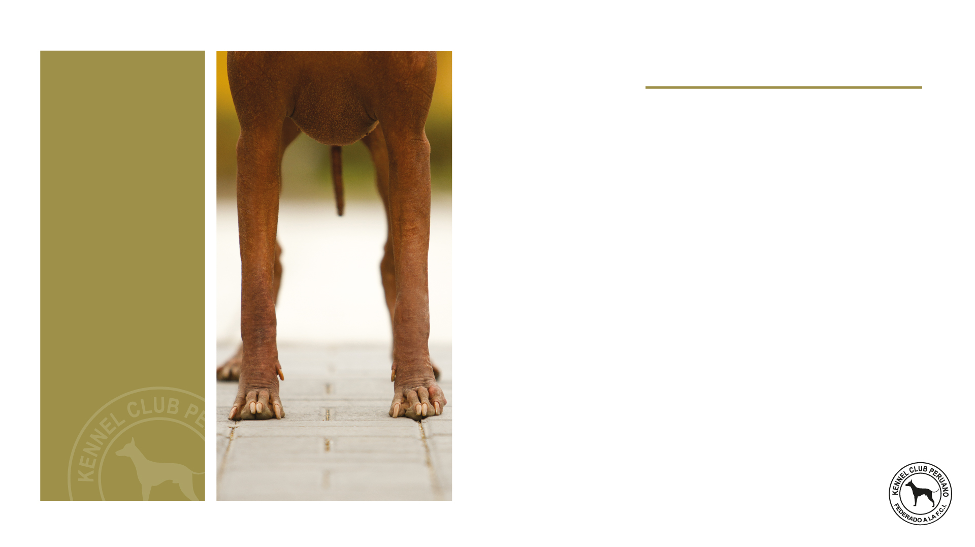
Chest
Body
Seen from the front, the chest perimeter must have good amplitude, but without excess; reaching almost to the elbow. The ribs must be slightly sprung, never flat. The chest, measured behind the elbows, must exceed the height at the withers with approximately 18%.
Underline and belly
The lower profile presents an elegant and well-marked line which goes from the lower part of the chest and rising to the belly which must be well tucked up, but without excess.

Slide 26
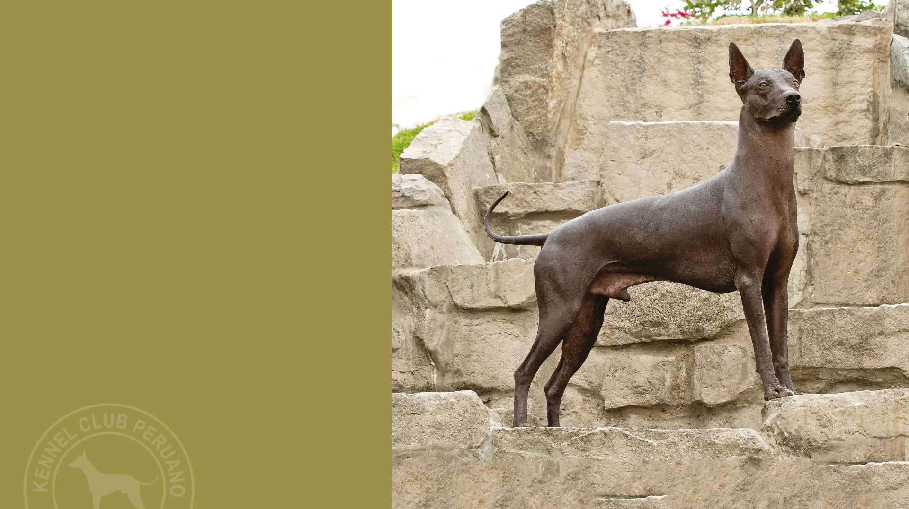
Tail
The tail is set on low, thick at the root it tapers towards the tip. When excited, the dog can carry the tail raised in a loose curve above the backline, but never as curved as being rolled up. At rest, it hangs with a slight upward curve at the tip. The tail is sometimes carried tucked in towards the abdomen. In length it almost reaches the hock. Tail to be complete.

Slide 27
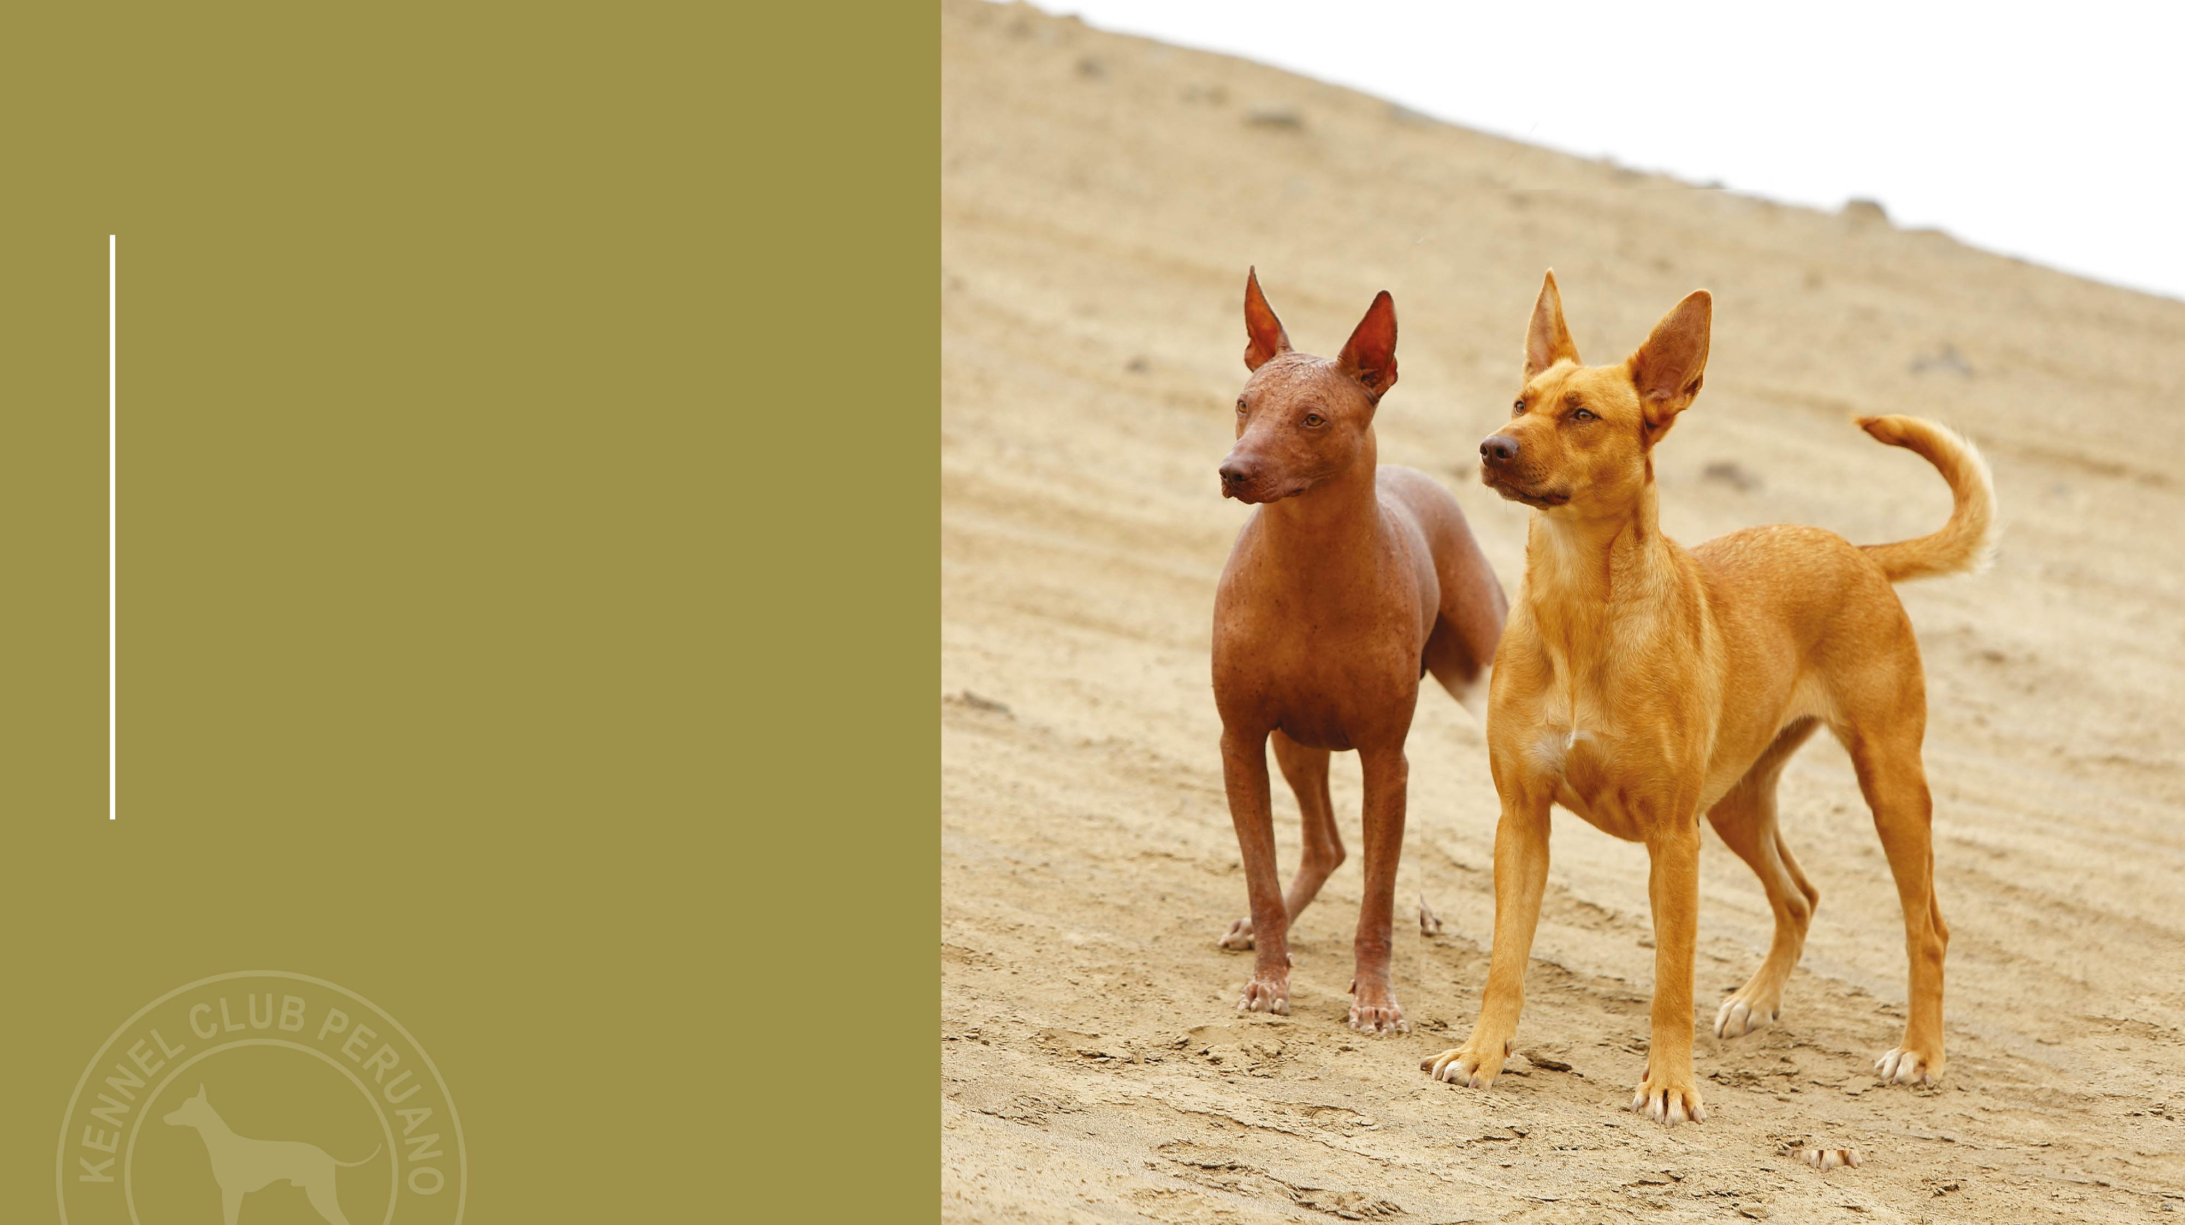
Limbs
01.
Forequarters
02.
Hindquarters

Slide 28
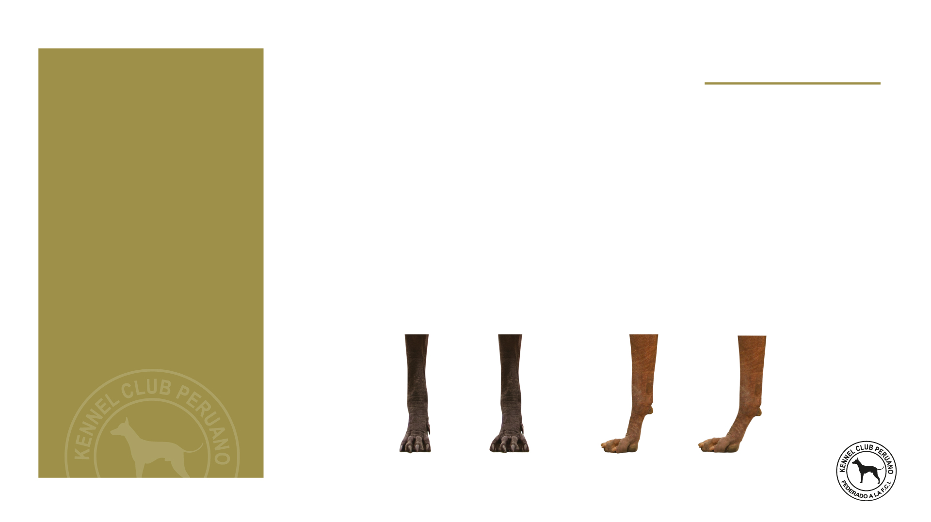
Forequarters
Limbs
Well united with the body, seen from the front they are perfectly upright with the elbows not turned out. The angle at the shoulder/upper arm varies between 100° and 120°. Seen in profile, the angle is 15° to 20°.
Forefeet: Are semi-long and look like hare-feet. The pads are strong and heat-resistant. The inter-digital membranes are well developed. The black dogs have preferably black nails and the lighter coloured dogs light nails.
01.
TYPES OF FOREFEET
Correct
Open
Correct
Weak

Slide 29
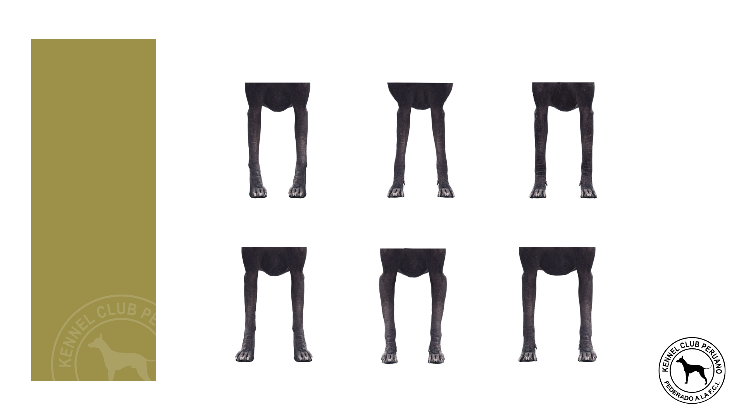
Forequarters
Limbs
01.
INWARD
TIGHT ELBOWS
CORRECT
TURNED OUT
ELBOWS OUT
TOO WIDE

Slide 30
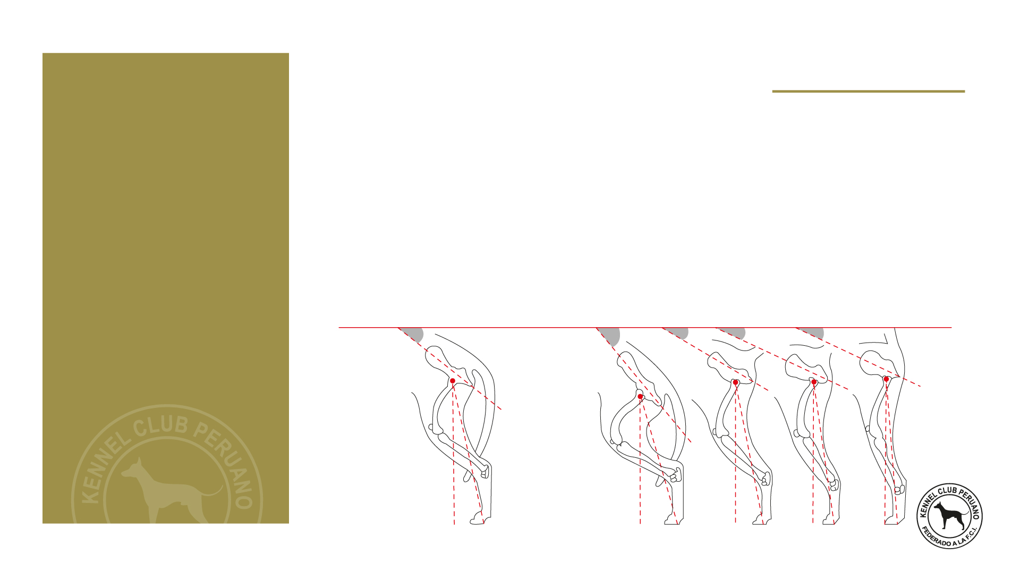
Hindquarters
Limbs
02.
The muscles are rounded and elastic. The curve of the buttocks is well marked. The coxo-femoral angle varies between 120° and 130°. The femoro-tibial angle must be of 140°. Seen from behind the hindquarters must be upright.
Hind feet: Same as forefeet.
CORRECT COXO-FEMORAL ANGLE
INCORRECT COXO-FEMORAL ANGLE
CROUP INCLINATION:
40°
50°
30°
25°
20°

Slide 31
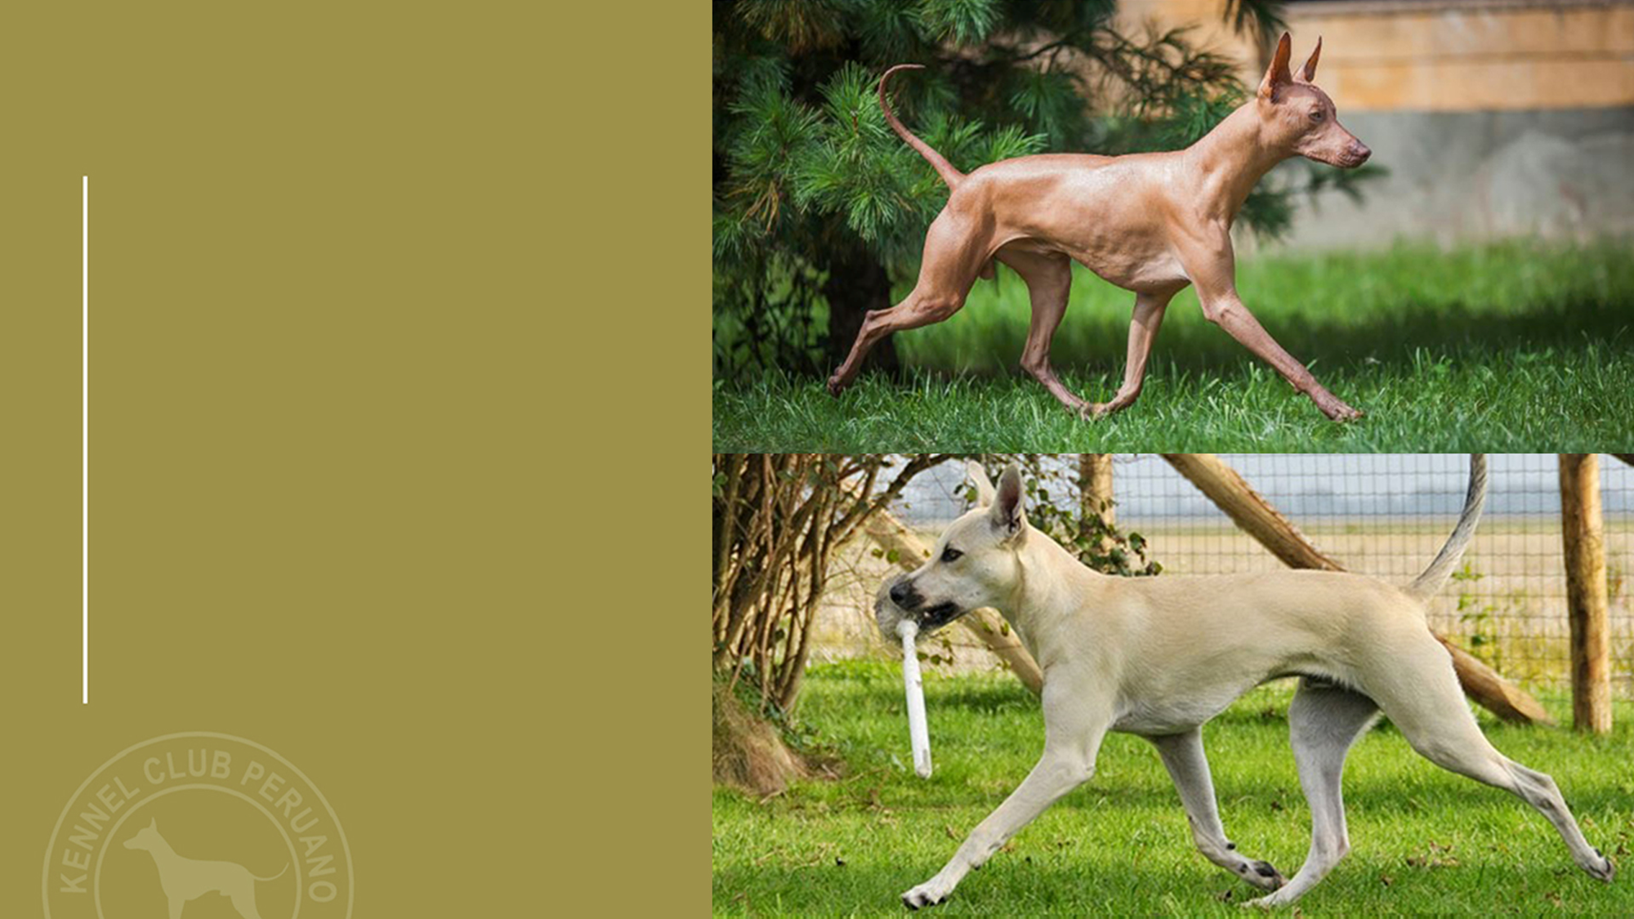
CORRECT
Gait / Movement
Due to the angulations defined at the description of the limbs, some of these dogs move with shorter steps but faster and at the same time quite soft and flexible.
The limbs, seen from front or behind must move in a single line (i.e. single tracking).
INCORRECT

Slide 32
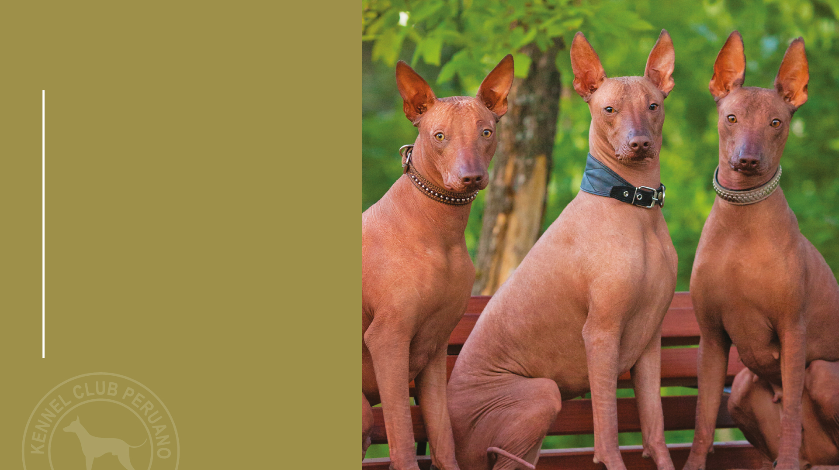
Skin
The skin must be smooth and elastic all over the body, but can form a few rounded almost concentric lines on the head and round the eyes and the cheeks in the hairless variety.
It has been verified that the internal and external temperature of the hairless dogs is exactly the same as that of other breeds (coated or not). The absence of hair leads to an immediate and direct emanation of heat, different from the coated subjects, where the heat filters through the coat by natural ventilation.

Slide 33
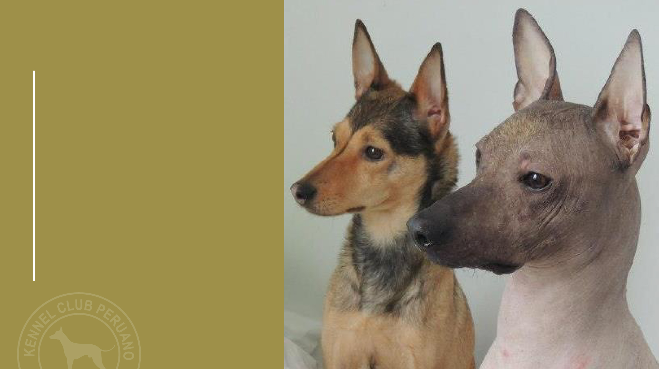
Coat
Hairless variety: Without hair, only very few hairs on the head and at the extremities of the legs and the tail are admitted, and sometimes sparse hair on the back. These hairs can be any colour or combination of colours.
Coated variety: Smooth, short and tight coat. The hair can be any colour or combination of colours.

Slide 34
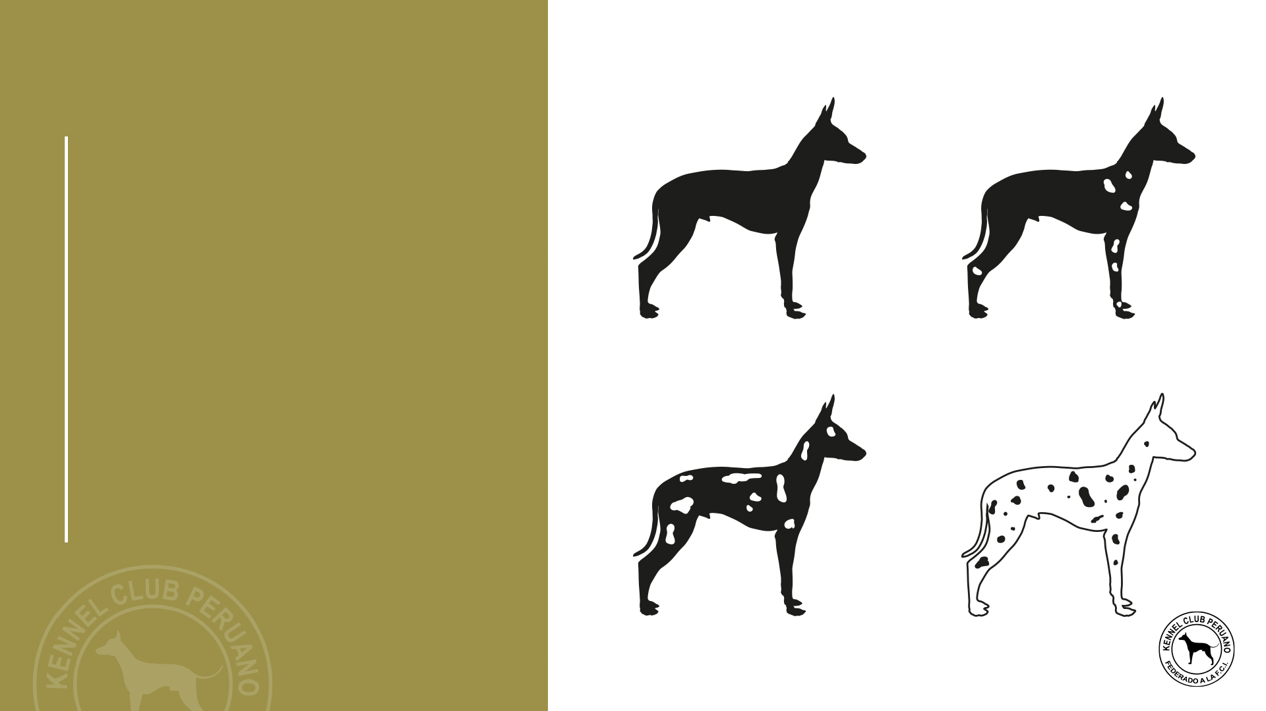
Hairless variety
Colour
CORRECT
CORRECT
The colour of the skin in the hairless variety can vary from black, slate black, elephant black, bluish black, the whole scale of greys (diluted black), bronze, copper, dark brown going to light blond.
All colours can be either uniform or show depigmented areas in any part of the body, preferable on the chest, legs and tail, nevertheless, the extension should not be more than 20% of all the skin. In equal conditions it is preferred solid colours.
SOLID COLOUR
DEPIGMENTED AREAS LESS THAN 20% OF THE SKIN
DISQUALIFYING
DISQUALIFYING
DEPIGMENTED AREAS MORE THAN 20% OF THE SKIN
DEPIGMENTED DOG

Slide 35
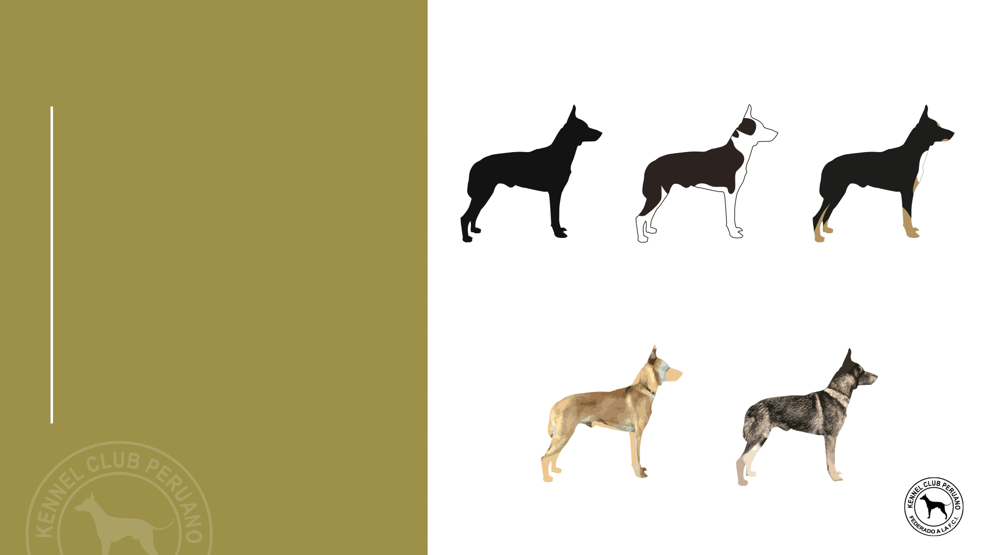
Colour
Examples of coated variety colours
The colour of the skin in the hairless variety can vary from black, slate black, elephant black, bluish black, the whole scale of greys (diluted black), bronze, copper, dark brown going to light blond.
All colours can be either uniform or show depigmented areas in any part of the body, preferable on the chest, legs and tail, nevertheless, the extension should not be more than 20% of all the skin. In equal conditions it is preferred solid colours.
SOLID / UNICOLOUR
BICOLOUR
TRICOLOR
FAWN
AGOUTI

Slide 36
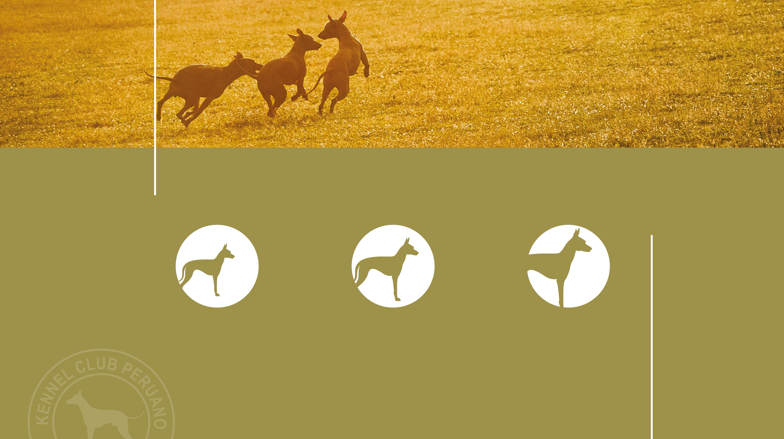
Size
There are three sizes in the males and females.
SMALL
MEDIUM
LARGE
25 - 40 cms.
41 - 50 cms.
51 - 65 cms.

Slide 37
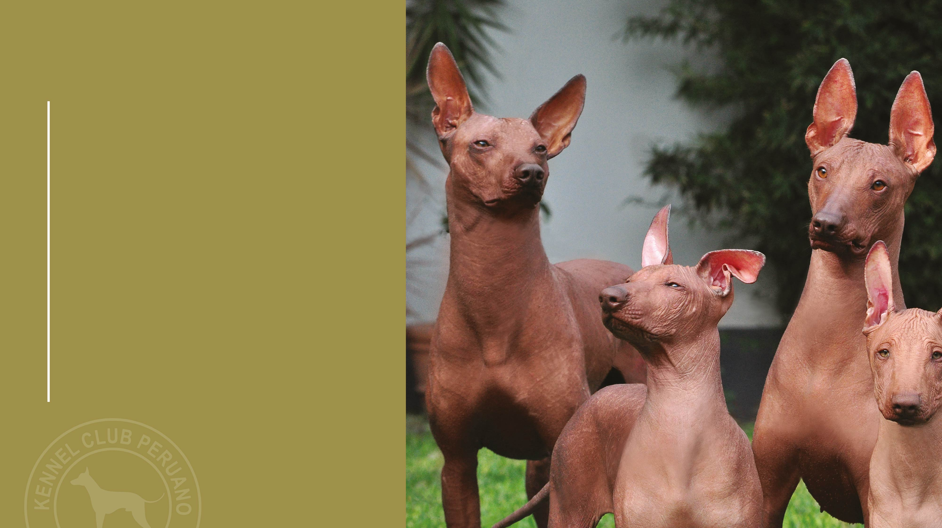
Weight
The weight is in relation to the size.
Small: 4 - 8 kg. Aprox. 8.8 - 17.6 pounds.
Medium: 8 - 12 kg. Aprox. 17.6 - 26.4 pounds.
Large: 12 - 25 kg. Aprox. 26.4 - 55.1 pounds.

Slide 38
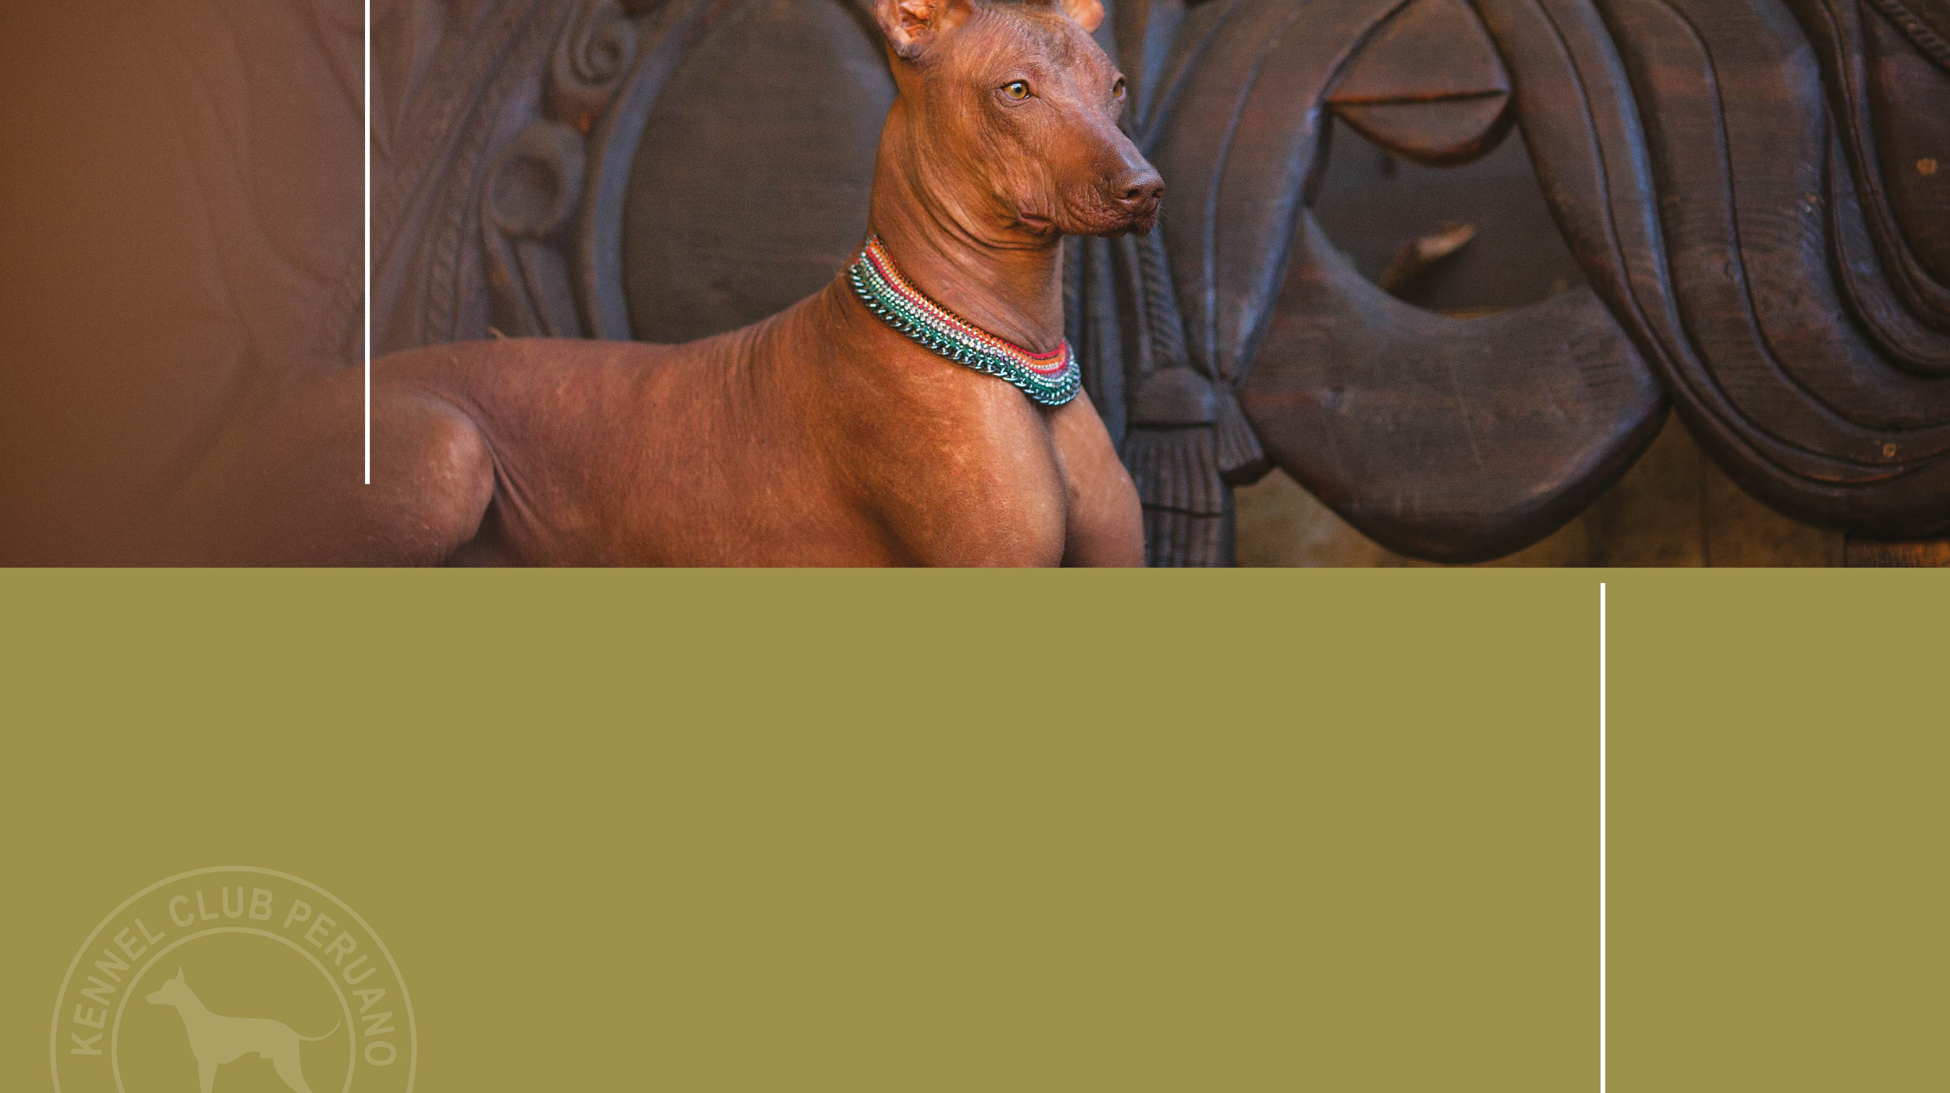
Faults
Any departure from the foregoing points should be considered a fault
and the seriousness with which the fault should be regarded should
be in exact proportion to its degree and its effect upon the health and
welfare of the dog.

Slide 39
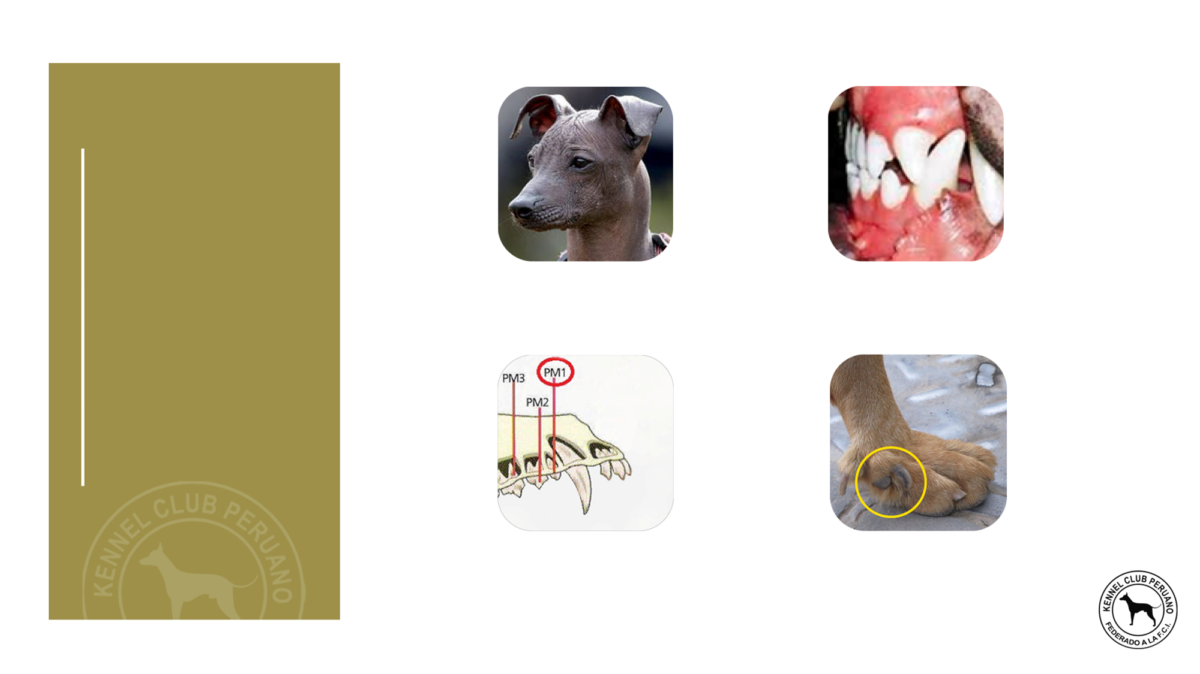
Faults
SEMI-ERECT EARS,
ONE OR BOTH
PINCER BITE
ABSENCE OF ONE PM1
IN THE COATED VARIETY
PRESENCE OF
DEWCLAWS

Slide 40
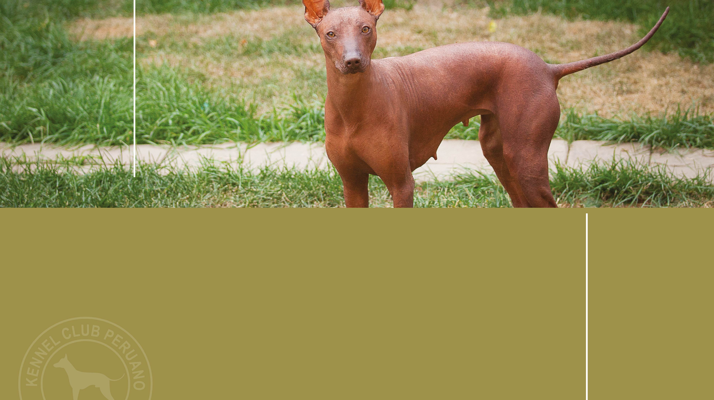
Disqualifying faults

Slide 41
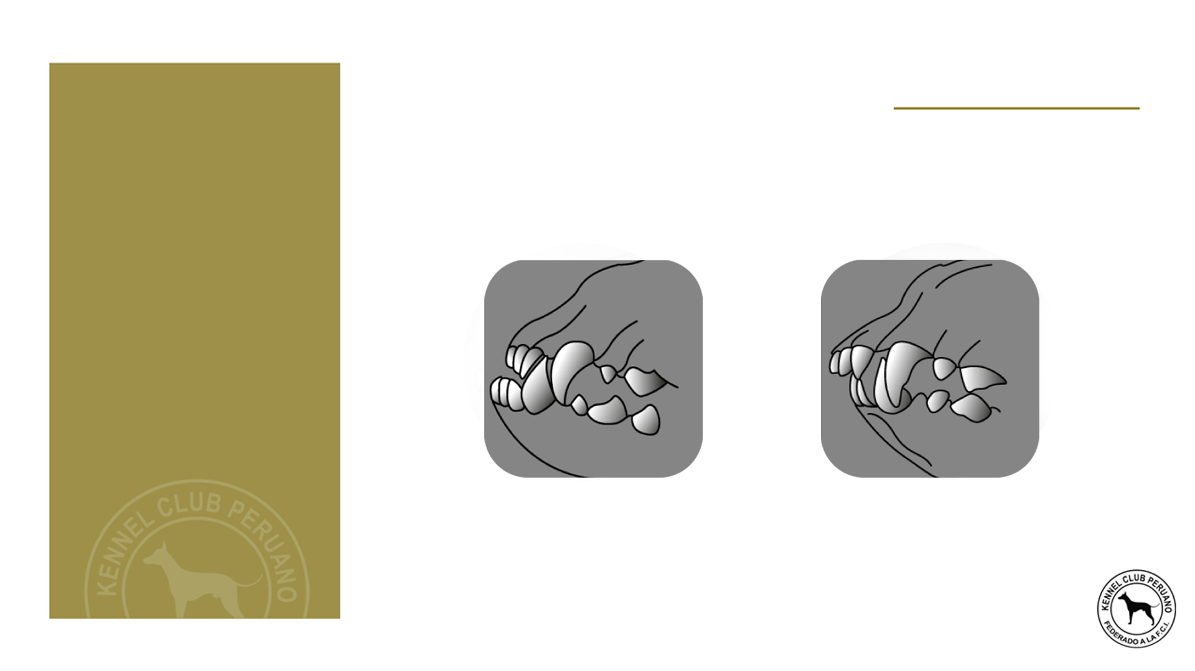
Disqualifying faults
AGGRESSIVE OR OVERLY SHY DOGS.
ANY DOG CLEARLY SHOWING PHYSICAL OR BEHAVIOURAL ABNORMALITIES SHALL BE DISQUALIFIED.
OVER OR UNDERSHOT BITE.

Slide 42
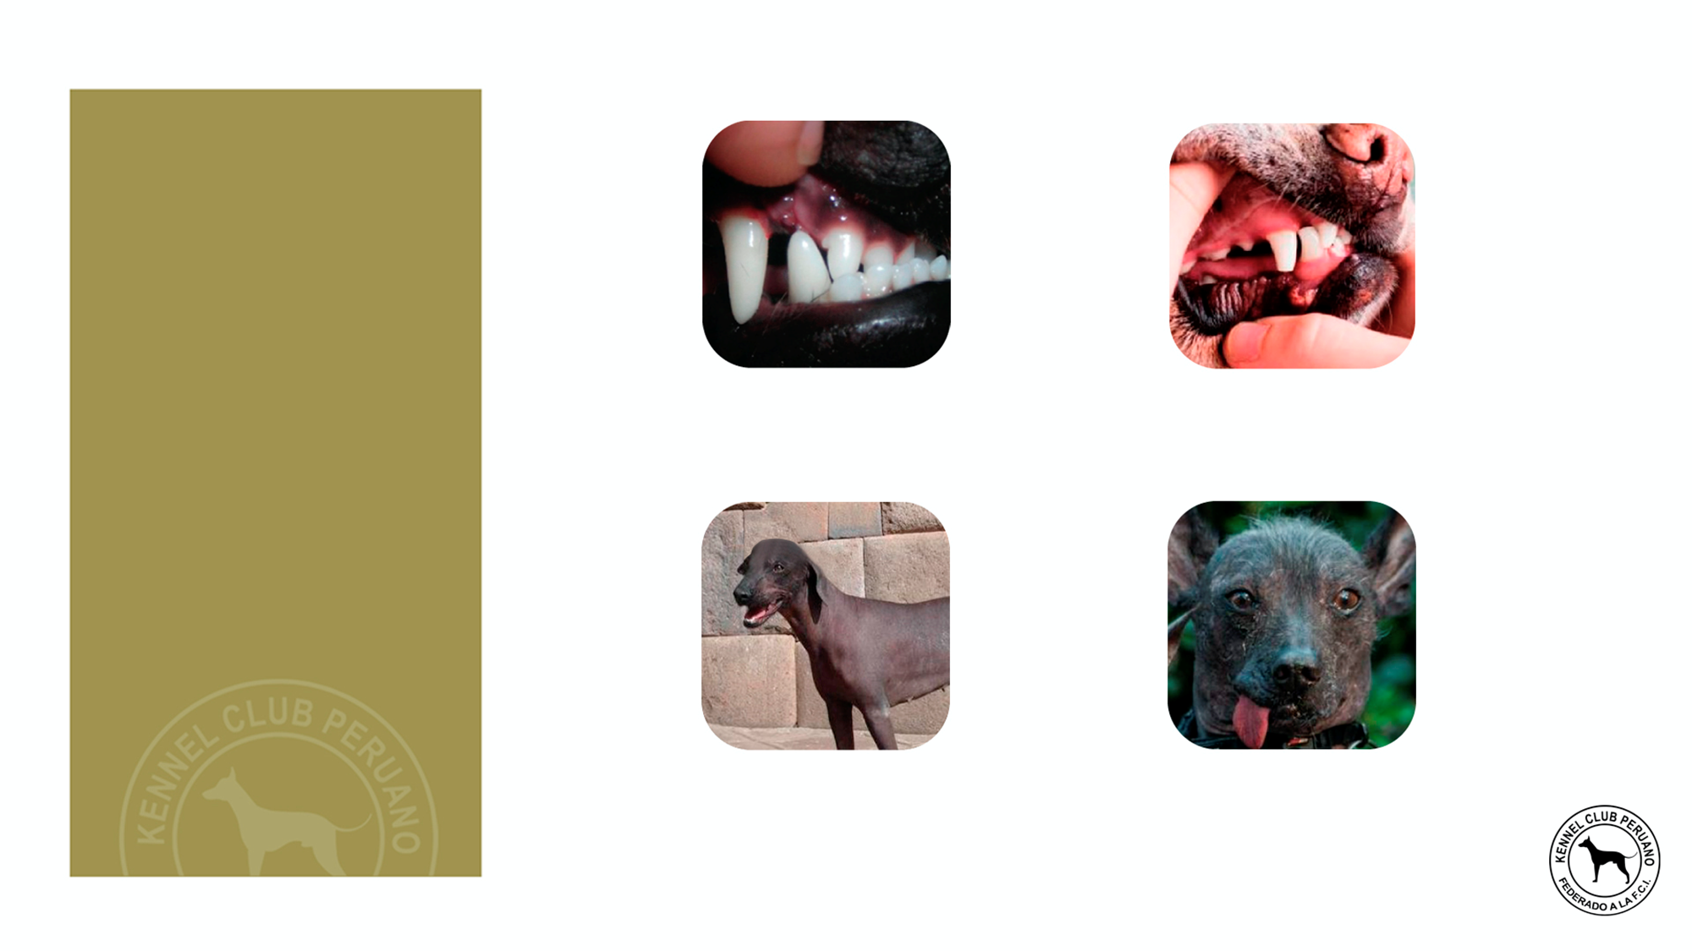
Disqualifying faults
DEVIATED JAW (I.E. WRY MOUTH).
MORE THAN ONE TEETH MISSING IN THE COATED VARIETY.
HANGING OR CROPPED EARS.
TONGUE NORMALLY HANGING OUTSIDE OF THE MOUTH (PARALYZED).

Slide 43
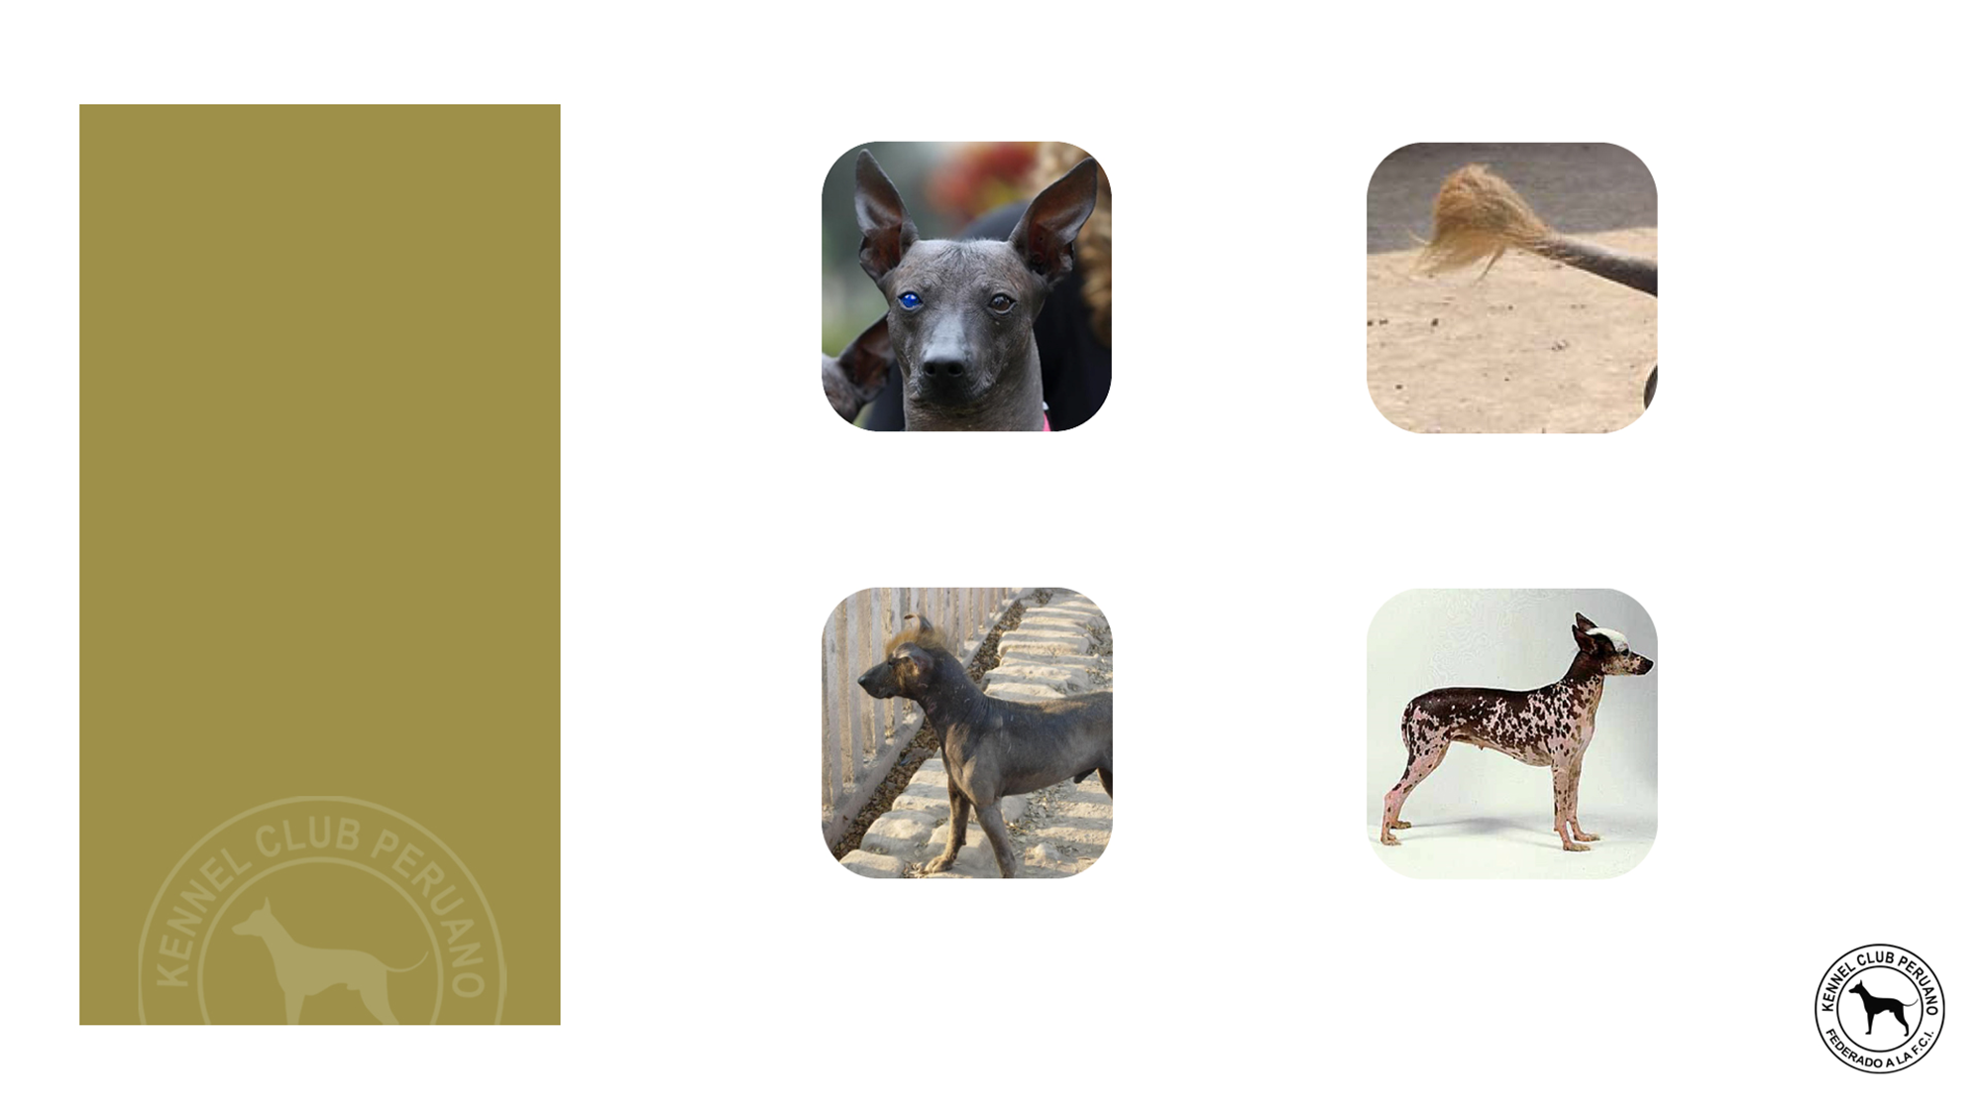
Disqualifying faults
EYES OF DIFFERENT COLOUR (HETEROCHROMATIC).
TAIL-LESS, SHORT TAIL OR DOCKED TAIL.
PRESENCE OF HAIR IN THE HAIRLESS VARIETY ON PARTS OF THE BODY NOT
INDICATED IN THE STANDARD.
MORE THAN 20% OF THE BODY
IS DEPIGMENTED IN THE HAIRLESS VARIETY.

Slide 44
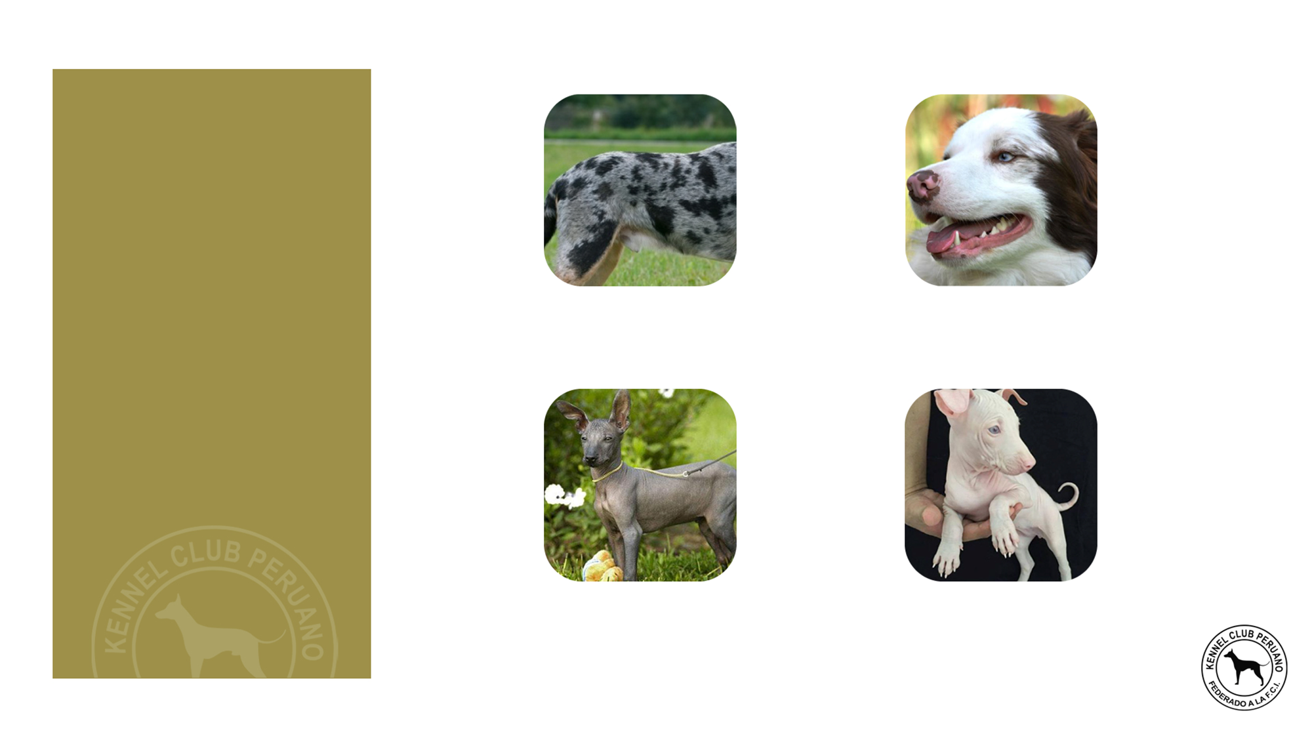
Disqualifying faults
MERLE COAT COLOUR IN THE COATED VARIETY.
TOTAL OR PARTIAL DEPIGMENTED NOSE.
HEIGHT MORE THAN 65 CM AND LESS THAN 25 CM.
ALBINISM.

Slide 45
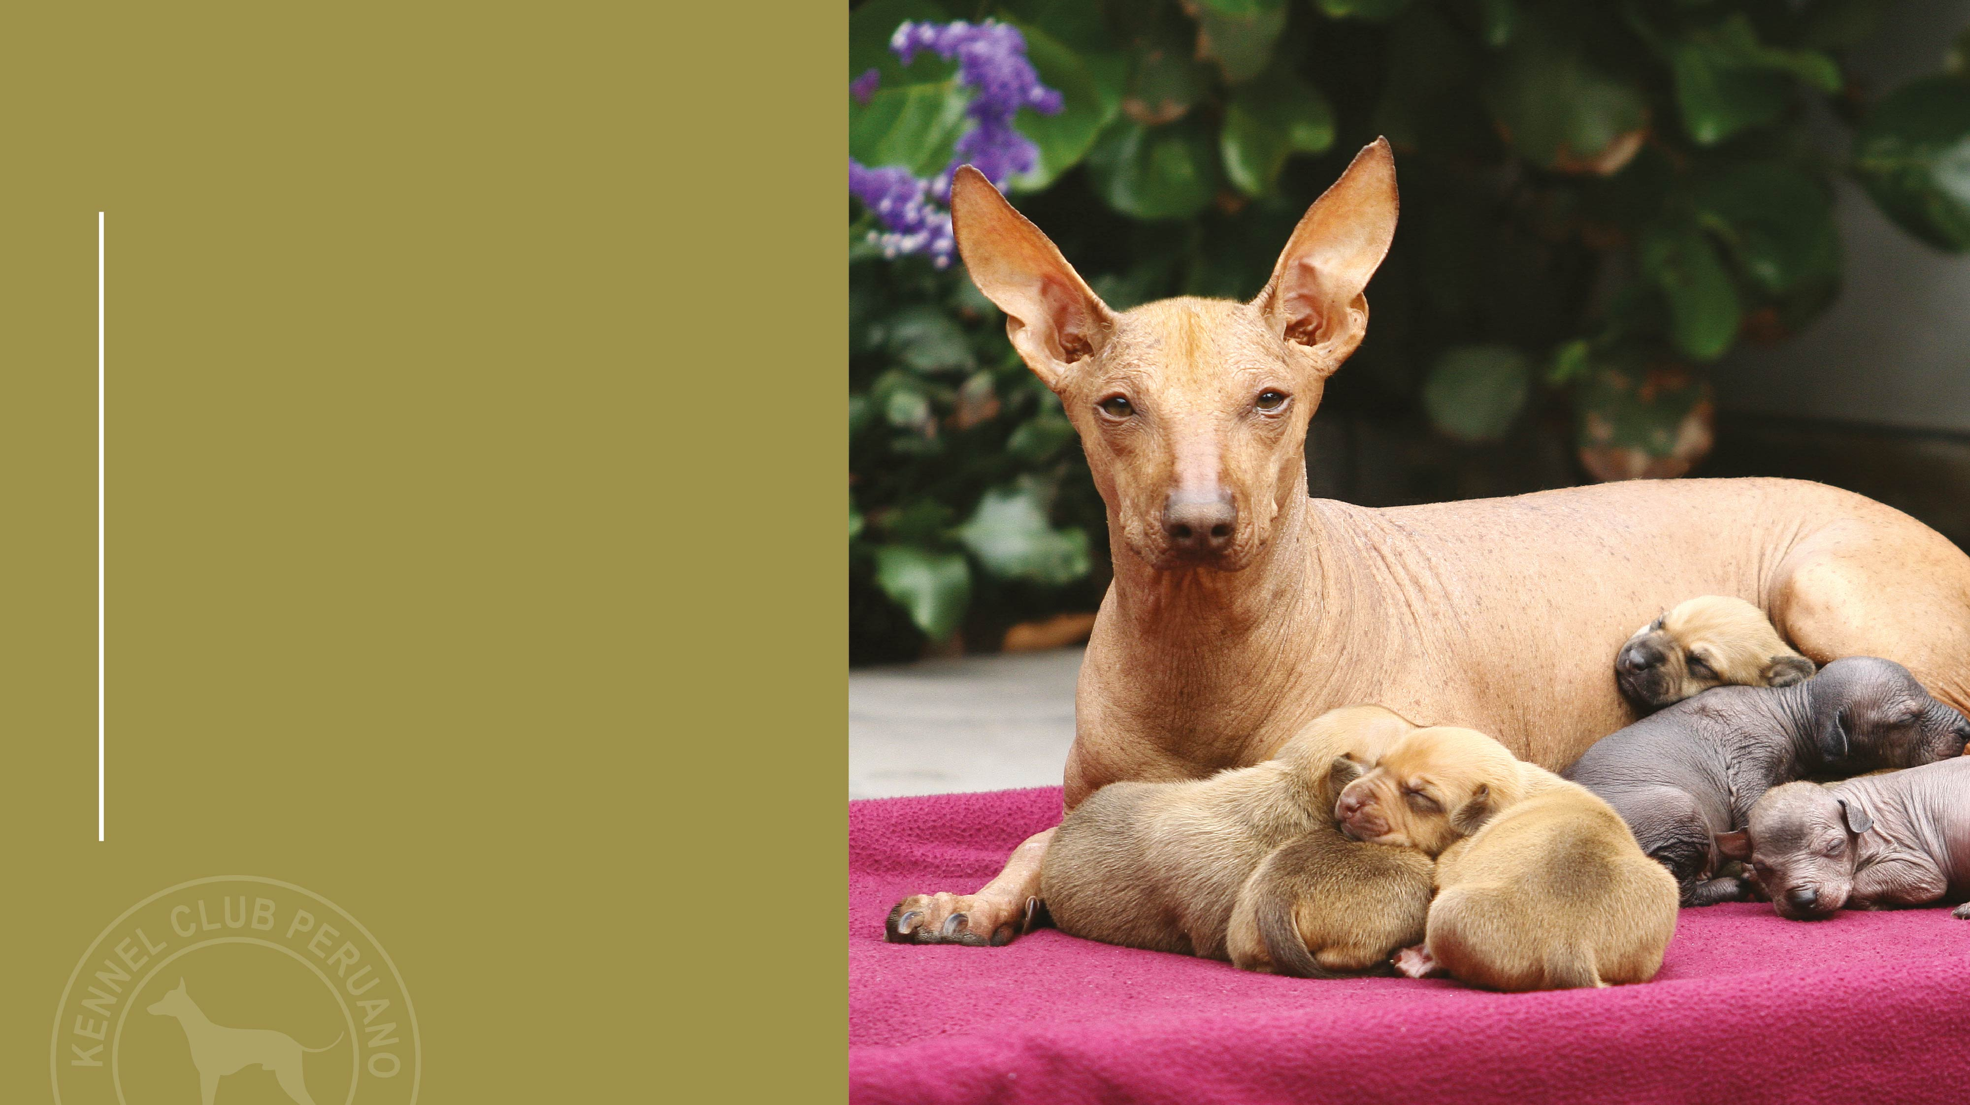
N.B.
Male animals should have two apparently normal testicles fully descended into the scrotum.
Only functionally and clinically healthy dogs, with breed typical conformation.

Slide 46

SPECIAL THANKS
Abel León
Ermanno Maniero
IMAGES / PHOTOGRAPHY:
Julio Aguilar
Marisa La Rosa
Valeria Kablova
Carlos Ramírez

Slide 47

THANK
YOU

